Slide 1
Ward Panel Meeting
Data retrieved from APRIL – SEPTEMBER-26
Team Members
PC PEREZ
PC TAVARES
PC JENKINS
PCSO Guleser Cater
Catford South Safer Neighbourhood Team

Slide 2
Ward Total Notifiable Offences for 6 Months-April-Sep 26
No. of incidents

Slide 3
Percentage of Crime
APRIL-SEP26 –

Slide 4
Ward Priority 1 – ASB- April-Sept 26
No. of incidents
Actions Taken by your Ward Team in line with Priority:-
1. Closure Orders
2. Home Visits
3. Multiple Community Protection Warnings/ Notices issued
4. Liaising with housing associations and local authorities
5. Targeted area patrols
Notes:
ASB tab
Daily last 4 weeks
Explore tab
Replace and change to monthly, print this screen and paste into word for cropping
Leave the heading to show CONNECT DATA ONLY

Slide 5
Ward Priority 2-Burglaries – April-Sept 26-
No. of incidents
Actions Taken by your Ward Team in line with Priority:-
1. CCTV enquiries surrounding burglaries
2. Burglary advice leaflet’s
3. Reassurance patrols in targeted area’s
4. Crime prevention advice
5. Identifying Suspects
Notes:
CRIME TAB
Leave the heading to show CONNECT DATA ONLY

Slide 6

Ward Priority 3 – Motor Vehicle Crimes- April-Sept 26
No. of incidents
Actions Taken by your Ward Team in line with Priority:-
Crime Prevention Advice
Reassurance
Vehicle Safety advice
Notes:
CRIME TAB
By classification Group Last Quarter – unclick all the offences and leave the one that represents the Ward Priority. Should you have a priority that isn’t listed such as speeding then this will have to be up for debate and changing.
Leave the heading to show CONNECT DATA ONLY

Slide 7
Robberies –April-Sept 26
No. of incidents
Notes:
CRIME TAB
By classification Group Last Quarter – unclick all the offences and leave the one that represents the Ward Priority. Should you have a priority that isn’t listed such as speeding then this will have to be up for debate and changing.
Leave the heading to show CONNECT DATA ONLY

Slide 8
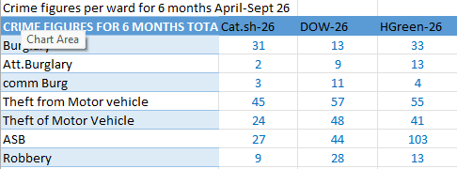
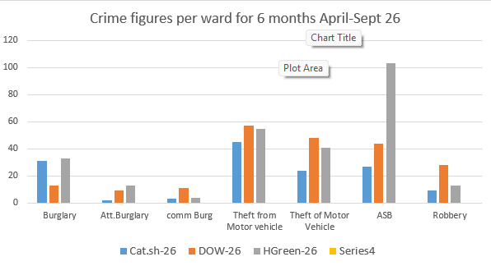

Slide 9

OP RETAIL – BP, BROMLEY ROAD, BR1
April to September
Between April and September, we continued to work collaboratively to deliver sustained, intelligence-led policing in Downham Woodland Walk and the surrounding retail area on Bromley Road, tackling anti-social behaviour and repeat shoplifting in partnership with specialist teams, including TSG.
During this period, similar enforcement activity was undertaken, resulting in numerous arrests of prolific offenders, disruption of persistent theft offences, and positive criminal justice outcomes, including custodial sentences and recalls to prison for high-harm repeat offenders.
Local businesses have continued to report a positive impact from this work, with retailers highlighting a reduction in offending and providing positive feedback regarding the increased police presence and the improved confidence and safety of staff.

Slide 10
Since the last Ward Panel meeting we have also undertaken the following activities:-
1. Mental health assessments
2. CPW,CPN issued
3. Coffee Morning
4. Targeted Patrols
6. Intelligence reports
7. Community Events
8. Arrest enquiries
9. Investigation
10. Closure Orders
If you or any other residents of the ward have any ideas for potential engagement opportunities or increasing the number of attendees at future Ward Panels please feel free to email our Mailbox at: catfordsouth.snt@met.police.com
Community Engagement

Slide 11
Notes:
CRIME TAB
By classification Group Last Quarter – unclick all the offences and leave the one that represents the Ward Priority. Should you have a priority that isn’t listed such as speeding then this will have to be up for debate and changing.
Leave the heading to show CONNECT DATA ONLY

