Slide 1
Ward Panel Meeting
Data retrieved from Oct25 – Mar26
Team Members
PC Hass Hassan
PCSO Guleser Cater
Catford South Safer Neighbourhood Team

Slide 2
Ward Total Notifiable Offences – Previous 6 Months
No. of incidents

Slide 3
Percentage of Crime
OCT25 – MAR26 %

Slide 4
Ward Priority 1 – ASB
No. of incidents
Actions Taken by your Ward Team in line with Priority:-
1. Closure Orders
2. Home Visits
3. Multiple Community Protection Warnings/ Notices issued
4. Liaising with housing associations and local authorities
5. Targeted area patrols
Notes:
ASB tab
Daily last 4 weeks
Explore tab
Replace and change to monthly, print this screen and paste into word for cropping
Leave the heading to show CONNECT DATA ONLY

Slide 5
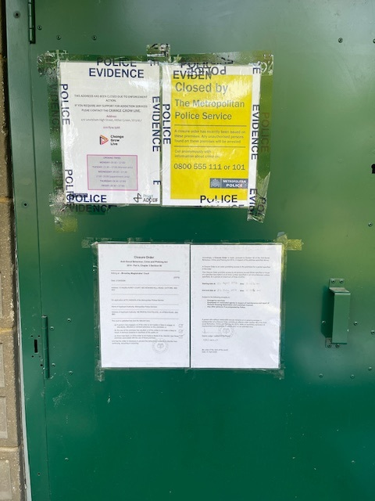
Ward Priority 1 – Anti Social Behaviour
CLOSURE ORDERS
We have successfully been granted an extension for FULL Closure Order for a property on HAZELHURST COURT, SE6, which had persistent ASB, Drug Activity and Crime originating from it.
Notes:
CRIME TAB
By classification Group Last Quarter – unclick all the offences and leave the one that represents the Ward Priority. Should you have a priority that isn’t listed such as speeding then this will have to be up for debate and changing.
Leave the heading to show CONNECT DATA ONLY

Slide 6
Ward Priority 2 - Burglary
No. of incidents
Actions Taken by your Ward Team in line with Priority:-
1. CCTV enquiries surrounding burglaries
2. Burglary advice leaflet’s
3. Reassurance patrols in targeted area’s
4. Crime prevention advice
5. Identifying Suspects
Notes:
CRIME TAB
Leave the heading to show CONNECT DATA ONLY

Slide 7

Ward Priority 3 – Motor Vehicle Crime
No. of incidents
Actions Taken by your Ward Team in line with Priority:-
Crime Prevention Advice
Reassurance
Vehicle Safety advice
Notes:
CRIME TAB
By classification Group Last Quarter – unclick all the offences and leave the one that represents the Ward Priority. Should you have a priority that isn’t listed such as speeding then this will have to be up for debate and changing.
Leave the heading to show CONNECT DATA ONLY

Slide 8
Robberies
No. of incidents
Notes:
CRIME TAB
By classification Group Last Quarter – unclick all the offences and leave the one that represents the Ward Priority. Should you have a priority that isn’t listed such as speeding then this will have to be up for debate and changing.
Leave the heading to show CONNECT DATA ONLY

Slide 9
Crime Comparison with other wards
Catford South vs Downham vs Hither Green vs Rushey Green
Use of knife or other sharp instrument Oct25 – Mar26

Slide 10

OP RETAIL – BP, BROMLEY ROAD, BR1
Since January, we have worked collaboratively to carry out sustained, intelligence‑led policing in Downham Woodland Walk and surrounding retail area on Bromley Road, tackling ASB and repeat shoplifting in partnership with specialist teams, including TSG.
This work has led to over 18 arrests, including at least 11 prolific offenders, with several receiving custodial sentences. Theft offending involving goods worth over £13,000 has been disrupted, and a high‑harm repeat offenders have been recalled to prison.
Local businesses have welcomed the impact, with a store manager writing to thank officers and confirm that staff now feel safer at work.

Slide 11
Since the last Ward Panel meeting we have also undertaken the following activities:-
1. Mental health assessments
2. CPW,CPN issued
3. Coffee Morning
4. Targeted Patrols
6. Intelligence reports
7. Community Events
8. Arrest enquiries
9. Investigation
10. Closure Orders
If you or any other residents of the ward have any ideas for potential engagement opportunities or increasing the number of attendees at future Ward Panels please feel free to email our Mailbox at: catfordsouth.snt@met.police.com
Community Engagement

