Slide 1


CHAPEL END WARD PANEL MEETING
19/05/2026
CHAPEL END WARD CRIME STATISTICS
01/02/2026 To 30/04/2026

Slide 2
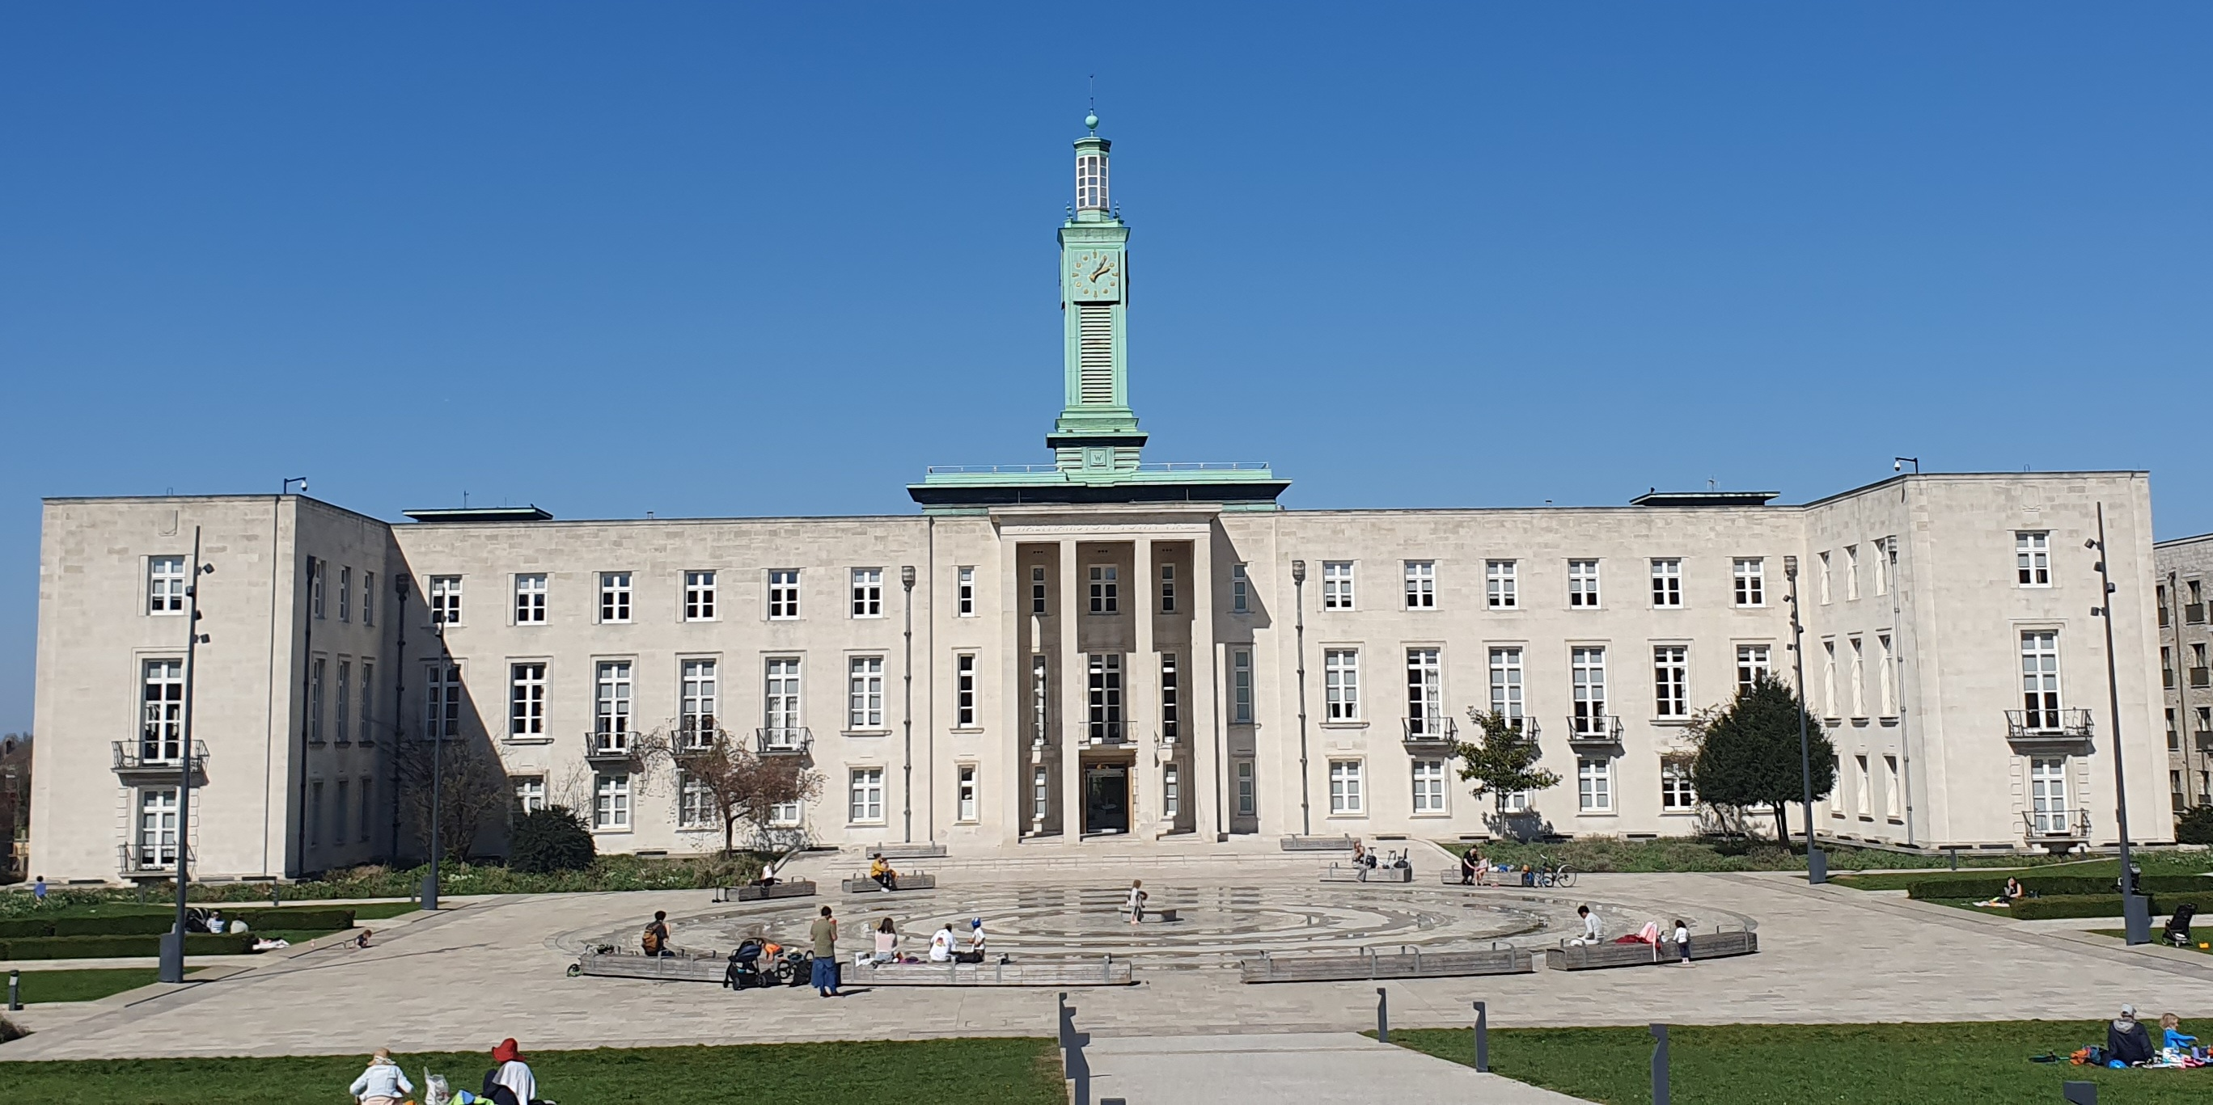

CHAPEL END SNT
Chapel End SNT
Abdul TARAFDAR
Police Sergeant
Shaz Majid
Police Constable
Lee JARVIS
Police Constable
Mobex number- 07920233816
Emma Wood
PCSO
Kwame PEPRAH
PCSO

Slide 3
WARD PRIORITIES & Next Ward Panel
Priorities Action taken
Targeted pulse patrols ongoing at the locations
Violence against Women and Girls (VAWG) – LLOYD PARK, KITCHENER PARK, BILLET UNDERPASS, CHESTNUTS FIELD
Targeting drug dealing around BROOKSCROFT ROAD, KITCHENER ROAD, BERESFORD ROAD, BRETTENHAM ROAD and the surrounding streets.
Motor Vehicle Crimes Hotspots - KENILWORTH AVENUE, GARNER ROAD, FOREST VIEW ROAD, BRETTENHAM ROAD
Pulse patrols are being conducted at the locations
Default patrols at locations. Conducting Street Briefing at the hotspots; Motor Vehicle crime prevention advice leafleting

Slide 4
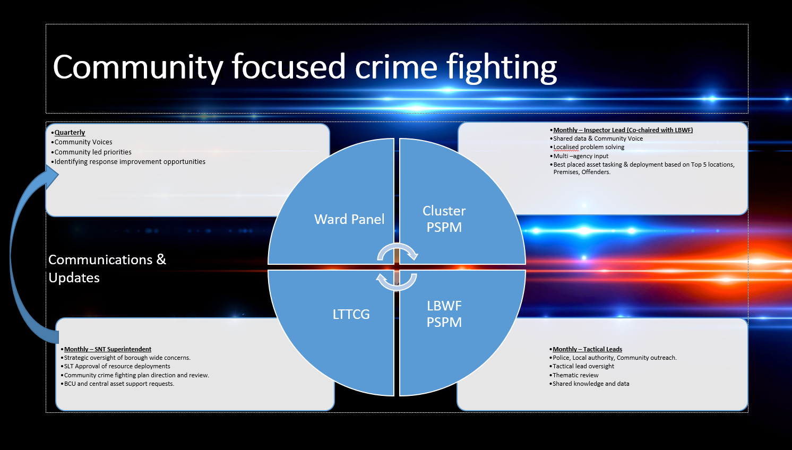

Slide 5
CRIME FIGURES CURRENT QUARTER
Ward | Res. Burglary
 | Feb | Mar | Apr
Chapel End | 2 | 5 | 3
CRIME FIGURES PREVIOUS QUARTER
Ward | Res. Burglary
 | Nov | Dec | Jan
Chapel End | 2 | 4 | 2

Slide 6
Burglary crime prevention advice
Burglars target windows as they can offer easier access than doors. Check how your windows look from the outside, removing potential access points where you can.
Are there walls, bins or garden furniture that could be used to reach windows?
Protection of a flat begins from the outside. Check that the managing agent or landlord cuts shrubs and planting back regularly so that they don’t obscure anyone from view or interfere with lighting or CCTV.
If you notice something’s not working properly or if a light is out, let the managing agent or landlord know so that it can be fixed straight away.
Keep cycle stores, bin stores, sheds and other covered areas locked and secured. These hidden spaces can attract loitering and lead to antisocial behaviour, especially after dark.
Your communal door is only effective if it is closed and secure, so always remember to check that it locks behind you. If it doesn’t, then report it to your management agent or landlord so it can be repaired quickly.
Don’t ever buzz anyone in that you don’t know – even if they say that they’re expected by another resident – or let them follow you in.
More advice can be found here: https://www.met.police.uk/cp/crime-prevention/

Slide 7
CRIME FIGURES CURRENT QUARTER
Ward | Robbery
 | Feb | Mar | Apr
Chapel End | 3 | 4 | 2
CRIME FIGURES PREVIOUS QUARTER
Ward | Robbery
 | Nov | Dec | Jan
Chapel End | 2 | 3 | 5

Slide 8
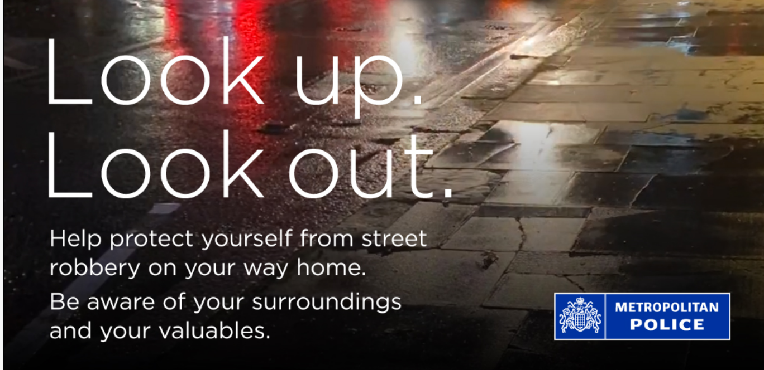

Slide 9
Protect your mobile phone against criminals on bikes and mopeds
Criminals often use bikes and mopeds to snatch mobile phones from people, particularly at busy locations such as outside stations, shopping centres or concert venues. Often victims are approached from behind while talking or texting on phones. Criminals on mopeds or bicycles may mount the pavement to grab the phone or snatch it from the road. Sometimes when it’s a moped, a pillion passenger will snatch it.
While most thefts happen between six and ten at night, criminals operate during the day too, so always look out for what’s going on around you. Follow these simple steps to help protect your phone.
Be aware of your surroundings
If you need to call or use your phone on the street, look out for anyone on a bike or a moped near you. Look up, look out
Make it quick so you don't become distracted
Don't text while you're walking – you won't notice what's going on around you
If that's not possible, stand away from the roadside, close to a building or wall, so no one can come up behind you
Going hands-free can prevent a thief from snatching your phone out of your hand

Slide 10
Protect yourself from mobile phone theft
Don’t leave your phone, iPad, tablet or camera unattended, out of your sight, or left on a table. Thieves can grab a phone from a table in seconds.
Be aware of your surroundings and only use your mobile when it feels safe to.
When you’ve finished using it, put it away.
Protect yourself from street robbery
Plan your route and think about what to take with you, especially if you’re going somewhere you haven’t been before. Keep to busy, well-lit streets, walkways and paths which are more likely to be covered by CCTV. Only take licensed taxis or minicabs booked by phone or a mobile phone app.
You are less likely to be targeted if you look confident. Move with purpose and try to be aware of your surroundings.
Be alert
We know it’s not always easy, but try to be aware of anyone near you when you’re at an ATM. Being aware of your surroundings and not being distracted makes it harder for people to take advantage and less likely that they’ll try to.
More advice can be found here: https://www.met.police.uk/cp/crime-prevention/

Slide 11
CRIME FIGURES CURRENT QUARTER
Ward | Theft from MV
 | Feb | Mar | Apr
Chapel End | 3 | 5 | 11
CRIME FIGURES PREVIOUS QUARTER
Ward | Theft from MV
 | Nov | Dec | Jan
Chapel End | 7 | 6 | 3

Slide 12
Prevent theft from a vehicle
Always lock it
Fuelling up or popping back into your house to get something are perfect examples of how easy it is to turn your back for a moment and forget your vehicle is unsecured. So get into the habit of locking your vehicle even if you’re only going to be away from it for a moment.
If your vehicle has wing mirrors that fold in automatically when locked, make sure you lock it properly. Criminal gangs are looking for vehicles like these where the wing mirrors are still out because it is clear to them that the vehicle has been left unlocked.
Close windows and the sun roof to prevent ‘fishing’
Leaving windows and the sunroof open invites fishing for items through the gap by hand or with, say, a bent coat hanger, which could also be used to unlock a door for them to get in. Thieves can be ingenious. Don’t give them the opportunity.
Secure your number plates with tamper-resistant screws
The easiest way to change the identity of a stolen vehicle or avoid speeding tickets and parking tickets is to fit stolen number plates. Using security screws to attach your vehicle’s number plates makes it harder for thieves to get your number.

Slide 13
CRIME FIGURES CURRENT QUARTER
Ward | Theft 0f MV
 | Feb | Mar | Apr
Chapel End | 5 | 4 | 3
CRIME FIGURES PREVIOUS QUARTER
Ward | Theft of MV
 | Nov | Dec | Jan
Chapel End | 5 | 4 | 2

Slide 14
Keyless entry
Cars with keyless entry unlock automatically when the key comes within a short distance of the car. This can be from inside a pocket or bag. If you have to push a button on your car key to open your car, you don't have keyless entry.
Keyless car theft or 'relay theft' is when a device is used to fool the car into thinking the key is close by. This unlocks the car and starts the ignition.
Thieves only need to be within a few metres of your car key to capture the signal, even if it’s inside your home. This means that even if your car and home are secure, thieves can still unlock, start and steal your car.
How to protect your keyless entry car
When at home keep your car key (and the spare) well away from the car.
Put the keys in a screened or signal-blocking pouch, such as a Faraday Bag and check if the bag or pouch is still working every few months.
Reprogram your keys if you buy a second hand car.
Turn off wireless signals on your fob when it's not being used.
More advice can be found here: https://www.met.police.uk/cp/crime-prevention/

Slide 15
CRIME FIGURES CURRENT QUARTER
Ward | ASB
 | Feb | Mar | Apr
Chapel End | 8 | 5 | 8
CRIME FIGURES PREVIOUS QUARTER
Ward | ASB
 | Nov | Dec | Jan
Chapel End | 10 | 6 | 9

Slide 16
CRIME FIGURES CURRENT QUARTER
Ward | VAWG
 | Feb | Mar | Apr
Chapel End | 1 | 1 | 0
CRIME FIGURES PREVIOUS QUARTER
Ward | VAWG
 | Nov | Dec | Jan
Chapel End | 0 | 1 | 0

Slide 17
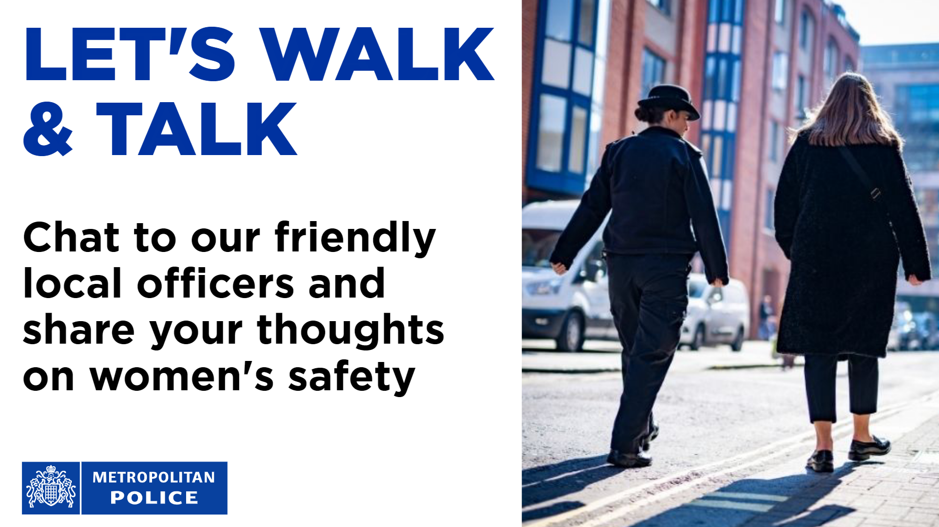

Slide 18
Emerging
Trends
Emerging crime trends as highlighted by partners and crime statistics

Slide 19
Tips for making other people feel safer on the streets
Some of this advice might seem obvious, but there are some simple things we can do to help other people feel safer when they're out in public.
Keep your distance
When walking behind someone, particularly at night, try to leave a good amount of distance between yourself and the person ahead of you. Remember that the closer you are, the more threatening you might seem.
Don’t stare
A stranger staring at you can be intimidating and unsettling. Focus on something else to show you’re not a threat. Look out of the window, message a friend, or read a book or newspaper.
Cross the road
Somebody running up behind you, particularly at night, can be frightening.
If you’re out for an evening run, or walk, and see someone walking ahead, cross the road, call out to let them know you’re about to run by them or make sure to leave a good amount of space when you pass them.
Keep comments to yourself
What you might think of as just a bit of fun, or flattery, can be insulting, upsetting or even scary to someone else. Keep any comments or opinions to yourself.
Keep your friends in line
If you're in a group of people where someone is harassing another person on the street, try to calm the situation. They may just need to be told that they're behaving inappropriately.
More advice can be found here: https://www.met.police.uk/cp/crime-prevention/

Slide 20
PLANNED OPERATIONS

Slide 21
GOOD WORK

Slide 22
Coming up
Cuppa with a Copper
11:30AM - 12:30PM, Sat 23 May 2026
Le Delice Cafe E17
Cuppa with a Copper
11:30AM - 12:30PM, Sat 27 June 2026
Le Delice Cafe E17
Next Ward Panel

Slide 23


Slide 24


Slide 25
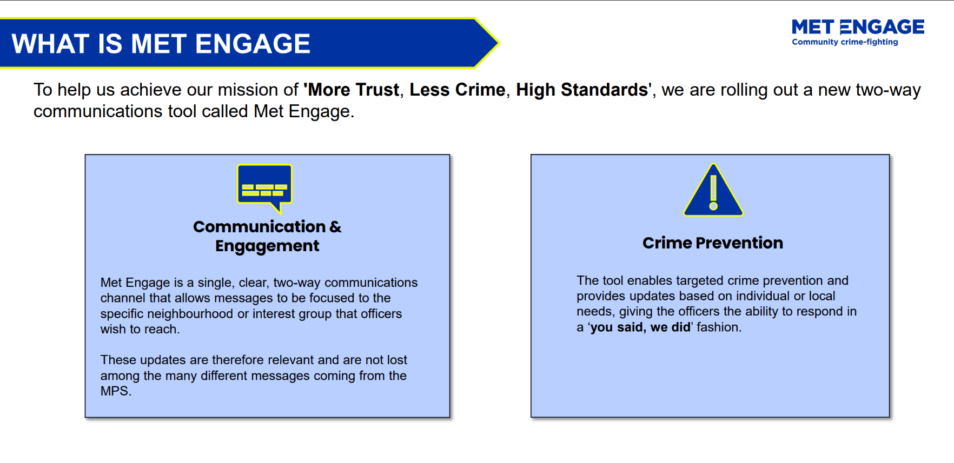

Slide 26
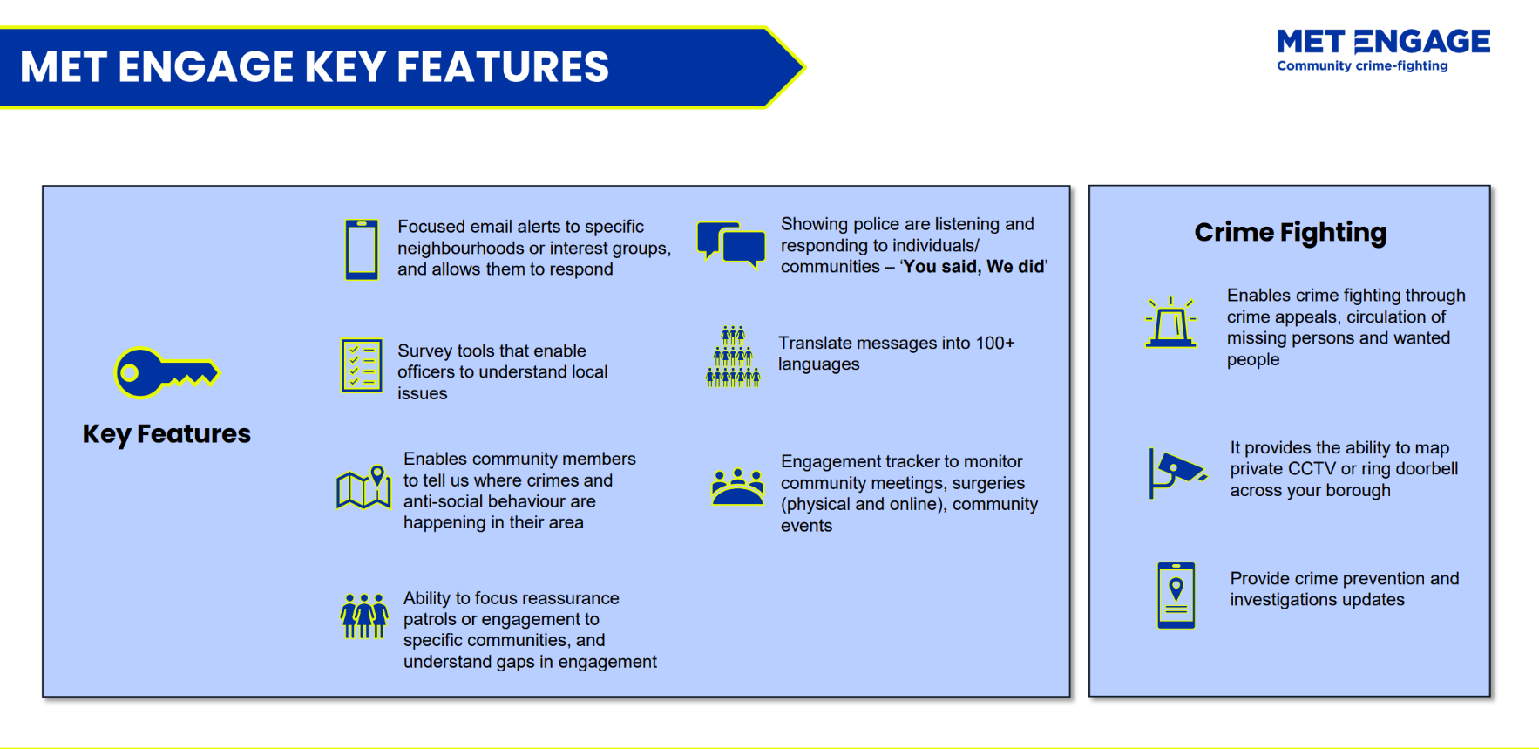

Slide 27
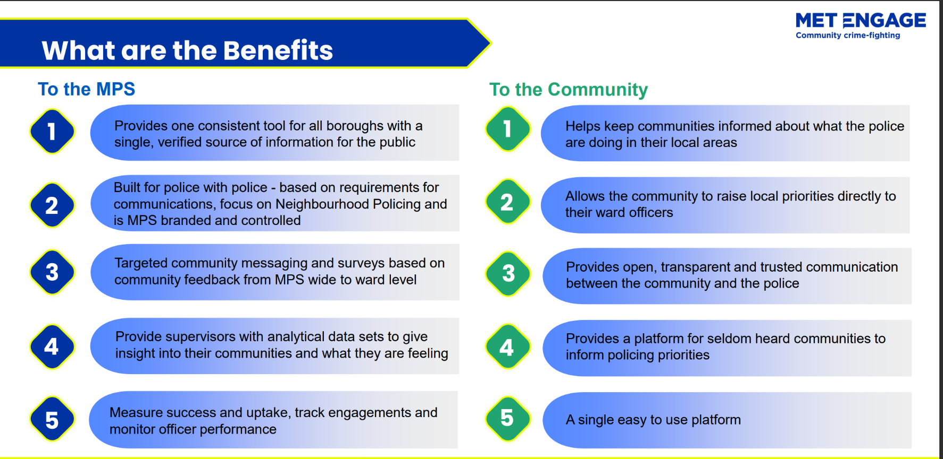

Slide 28
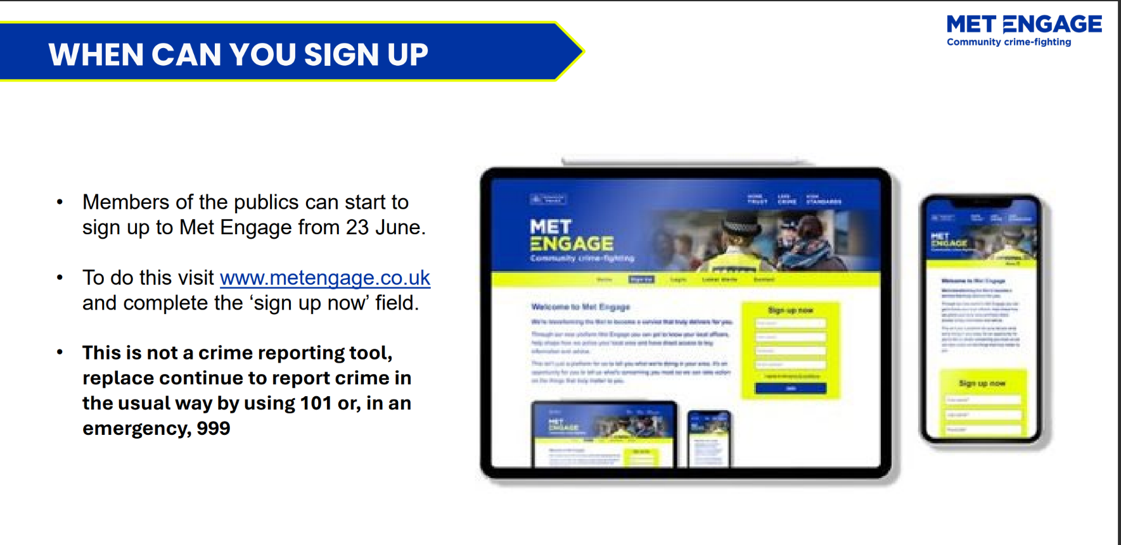

Slide 29


Slide 30
In Emergency - 999
No- Emergency -101 or online : https://www.met.police.uk/ro/report/ocr/af/how-to-report-a-crime/
Contact: Chapel End Safer Neighbourhood Police Team email : ChapelEnd@met.police.uk

