Slide 1
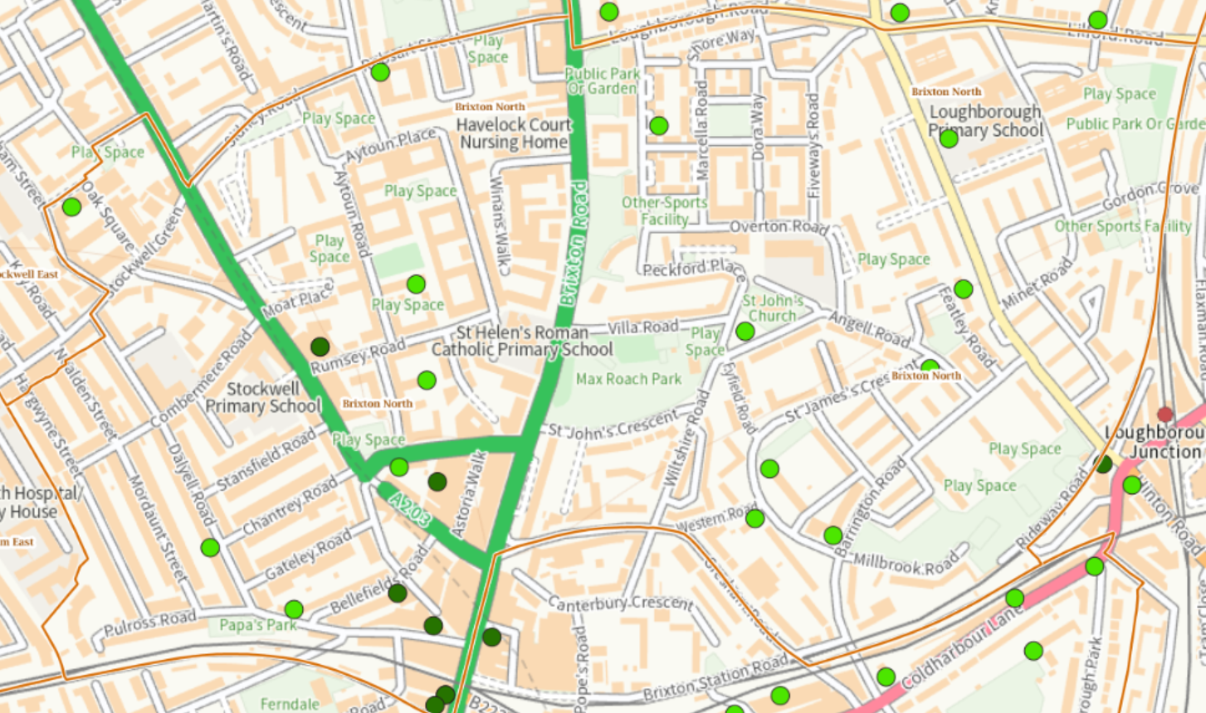

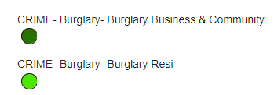
Burglary last 3 months:
July – September:
Business Burglary X6 Down by 1 (7)
Residential Burglary X15 Up by 8 (7)
Trends:
Parcel Theft from Communal Area X1
Bike Stolen X3

Slide 2
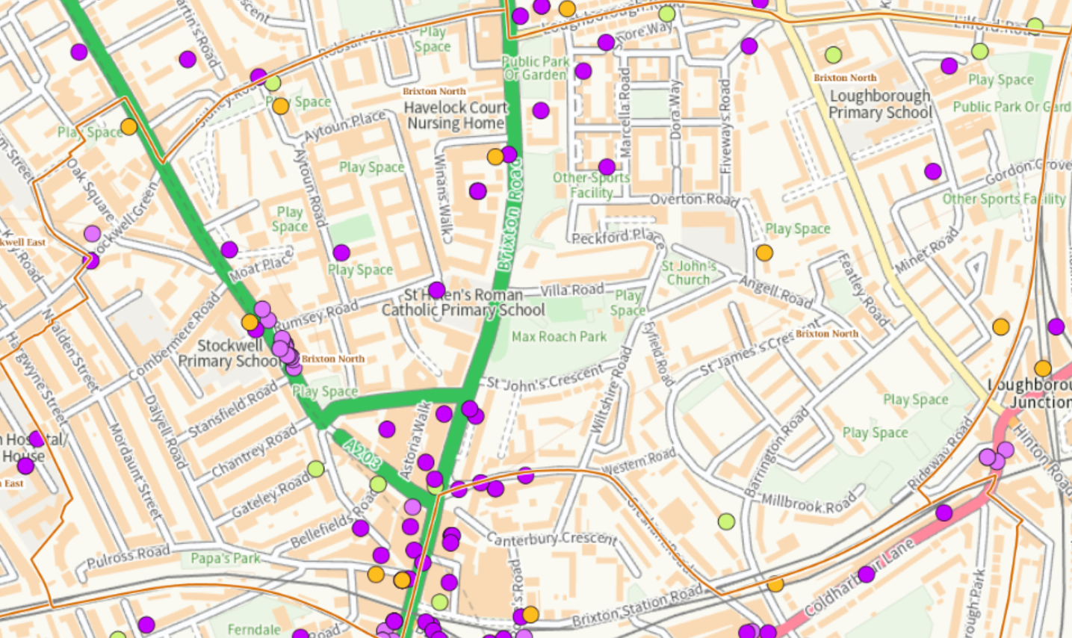
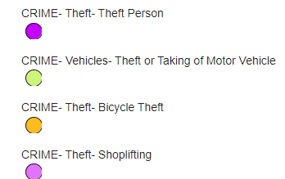
Theft and vehicle theft last 3 months:
July – September:
Bicycle theft X8 Down by 3 (11)
Theft of and from Motor Vehicle X8 Same (8)
Shoplifting X20 Up by 5 (15)
Theft from Person X27 Down by 7 (34)
Trends:
Vehicle Stolen X8
Snatch Theft X11
Pickpockets X3

Slide 3
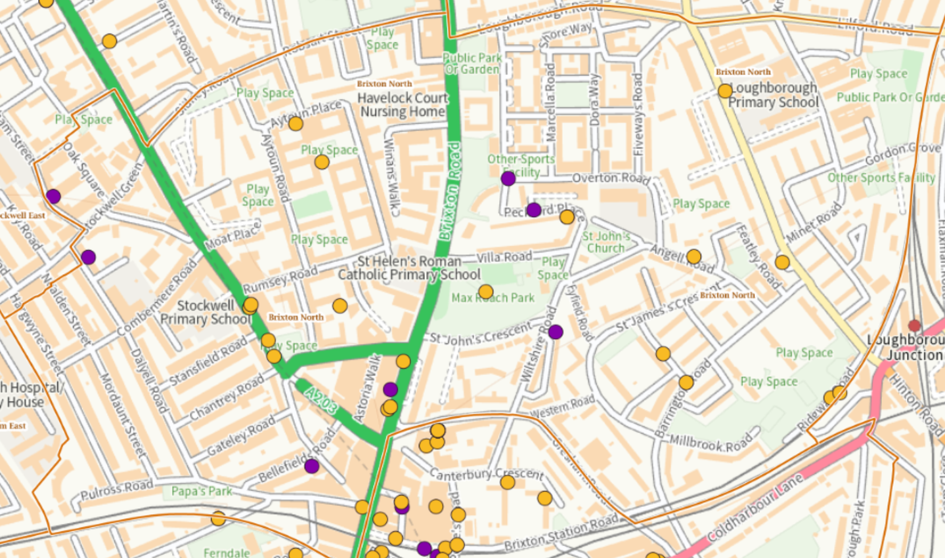

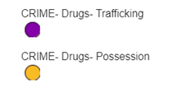
Drug Trafficking and possession last 3 months :
These stats do not show Drug using/taking.
Drug Possession comes from drugs found on stop and search whereas Trafficking comes from importing and county lines.
July – September:
Class B Cannabis X13 Same (13)
Cass B Cannabis PWITS X1 Same (1)
Class A X2 Down by 2 (4)
Class A PWITS X0 Down by 2 (2)
Class C PWITS Nos Gas X1 Same (1)
Importing Drugs X6 Up by 5 (1)
*PWITS - Possession with intent to supply

Slide 4
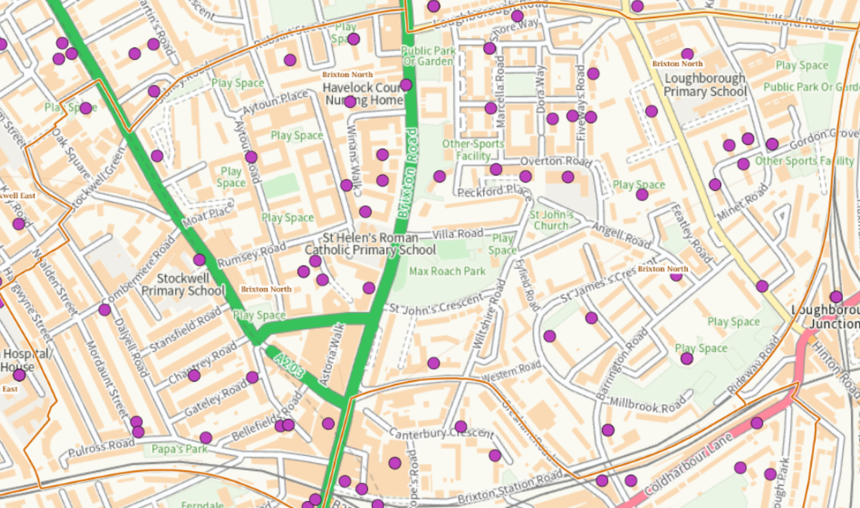

Violence against women and girls last 3 months:
July – September:
53 Incidents Up by 9 (44)
This is not necessary violence against woman however; the figures show all the incidents where a female is classed as a victim of crime.
Notes:
List of VAWG Safe Havens in Brixton. this is the Lambeth website: https://www.lambeth.gov.uk/community-safety-anti-social-behaviour/violence-against-women-girls-vawg/safe-havens-directory. There are no safe havens as yet in Brixton North. The Minet Library and Brixton Recreation Centre are the nearest.

Slide 5
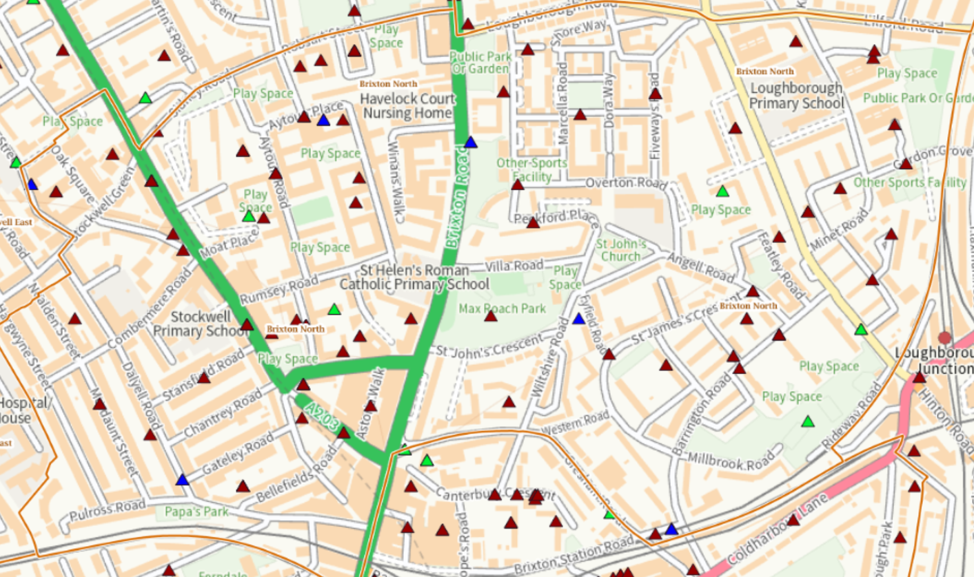
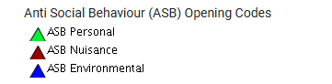
ASB Statistics last 3 Months:
Opening Codes is what the call is opened as at the point of reporting.
July – September:
ASB Personal 5 Up by 3 (2)
ASB Nuisance 58 Up by 4 (54)
ASB Environmental 6 Up by 4 (2)
Most common forms of ASB:
Neighbour disputes
Noise
Drug users
Youths congregating

