Slide 1
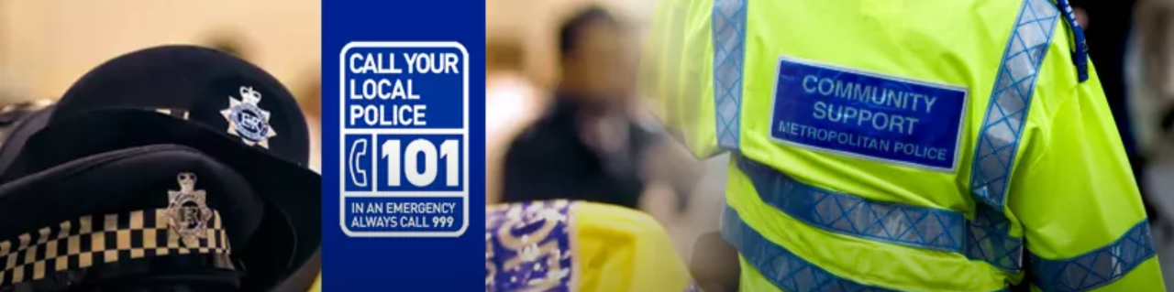

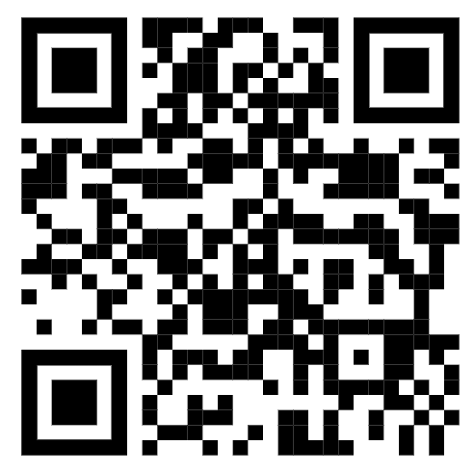


Upcoming local NPT Events
Witness Appeal
Meet the team at the below events to discuss issues in
your area
Crime Prevention Stall @ Grove Road Retail Park
Sunday 25/10/26 – 3pm – 4pm
Residential Burglary
On 24/10/2026, suspect(s) have tried to access front door of property at 1743hours
Crime report ref:01/8223447/26
Do you recall seeing or hearing anything suspicious during these times? Do you have CCTV of the incident? Do you remember seeing any persons or vehicle loitering in the area.
Please phone Police Non-emergency on 101 or report at www.met.police.uk and quote the above reference number
Useful contact details
Police (Non Emergency) 101
Crimestoppers 0800 555 111
Your local Safer Neighbourhoods Team is Chadwell NPT
Sign up for our new engagement platform Met Engage where you can get to know your local officers, help shape how we police your local area and have direct access to key information and advice
Visit metengage.co.uk or scan the QR code

Slide 2
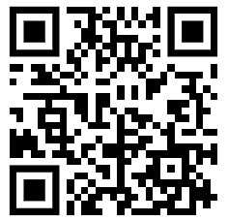
Incident Details
Your local Safer Neighbourhood Team
Home Crime Prevention Advice
Vehicle Crime Prevention Advice
Leave a light on if it will be dark before you return home or install timer switches on lamps.
Consider installing a visible burglar alarm or CCTV. Whatever your budget will allow.
Always LOCK windows and doors with the key. Doors that are not locked with the key are insecure.
In the garden ensure any dark areas have sensor lights. Planting spikey plants such as pyracantha can deter access in vulnerable areas.
Keep tools locked in sheds or outbuildings. Don’t let a burglar use your tools to gain access.
Always check who’s at the door before you open it. Use your door chain. Don’t open it if you feel anxious or scared. Genuine callers won’t mind having their identity checked. If you are unsure call the police or a neighbour
Protect your car keys: Keep keys with you at all times and out of sight of windows or letterboxes. If you have a keyless vehicle, make sure you keep them safely stored in a signal blocker bag and that you check to make sure the bag is working regularly.
Consider adding secondary security to your vehicle such as an immobiliser, alarm or a visual deterrent such as a steering wheel lock. If you have a driveway consider a parking post.
Remove all valuable items including small change.
Did you know it is actually illegal to leave your vehicle running unattended while you de-ice, or warm it up in the cold weather? If someone takes it while left like this your insurer won’t pay out because you won’t be covered.
Join the Chadwell NPT Ward Panel
Register your property for free at www.immobilise.com
Find out what is happening in your are at www.met.police.uk/area/your-area/
Would you like to have your say on the local policing priorities for your area?
Contact the team to join your local ward panel.
Ward panels are made up of residents, business owners, statutory partners and local councillors. We meet every 8-12 weeks to discuss local issues and determine how we police your area.
For the latest crime prevention advice visit www.met.police.uk/cp/crime-prevention/
or scan the below QR code

