Slide 1
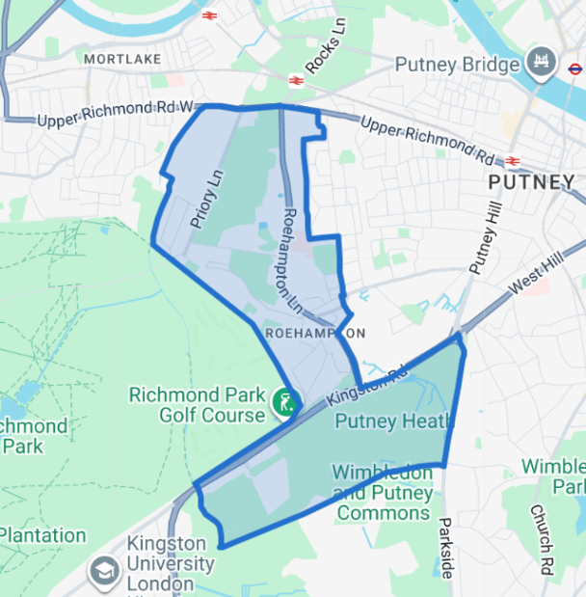
Ward Panel Meeting
Roehampton, Tuesday 19th May 2026 at 7pm – 8pm
Microsoft Teams
Ward Panel Chair – Tatiana Dobreva

Slide 2
Introductions
The Roehampton team consists of the following ward officers:
PS Mat Knowles
PC Roberta Gavin
PC James Quail
PC Christopher Mageean
PC Galal Ahmed
PCSO Denise Russell
Email: roehampton@met.police.uk

Slide 3
Introductions
Welcome All!
Please respect each other and the police
Please hold questions until the end of each priority
Please refrain from asking questions outside of the agenda
If you have any further questions, please email or pass them to the Ward Chair ☺

Slide 4
Agenda
Ward Priorities
Crime Data Figures
Police Activity
Met Engage
Abstraction rates
Planned future engagements
Q&As
Setting New Priorities

Slide 5
Ward Priorities and Crime Trends
Violence against the Person
Anti-social Behaviour
Motor Vehicle Crime

Slide 6
Crime Data Figures
 | Current Period Feb 26 – April 26 | Previous Period Nov 25 – Jan 26 | Difference | 12-month comparison Feb 25 – April 25 | Difference 2025 – 2026
Burglary | 13 | 19 | -6 | 15 | -2
Robbery | 5 | 7 | -2 | 6 | -1
Theft Person | 7 | 8 | -1 | 9 | -2
Shoplifting | 10 | 3 | +7 | 20 | -10
Vehicle Crime | 22 | 29 | -7 | 33 | -11
Sexual Offences | 14 | 13 | +1 | 8 | +6
ASB | 89 | 91 | -2 | 155 | -66

Slide 7
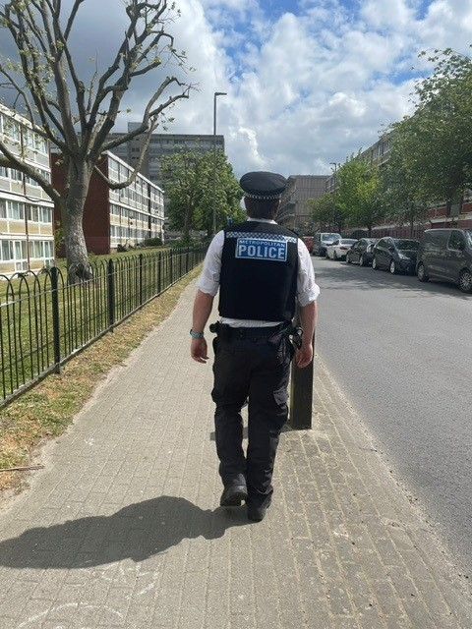
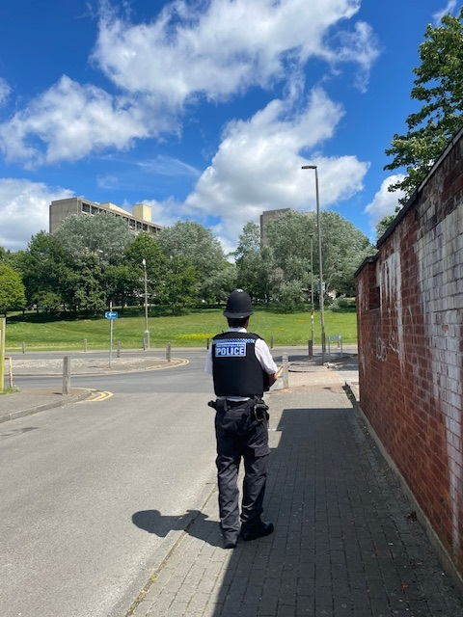
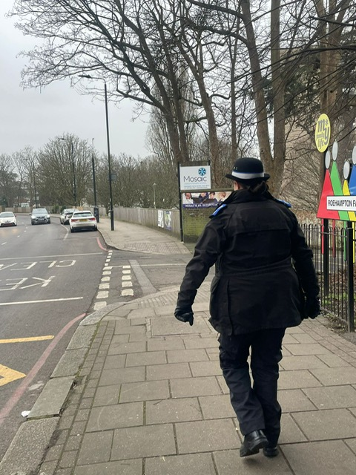
Police Activity
Patrols
We’ve conducted various of high visibility and plain-clothes patrols across the area the last quarter.
Directed towards known hot spots and areas specified by your information.
We’ve been tasked to conduct high visibility patrols at the Synagogue and Mosaic Primary School following recent tension elsewhere in London.
Patrols included schools in the borough as reassurance against the 'School Wars' trend.

Slide 8

Police Activity
Engagements
We’ve attended the Roehampton Hub for a Youth Forum day activity on Friday 20th February. Engagement with the Youth Voice Wandsworth. Where we had discussions with the youth on safety concerns, their rights and how we can improve dealing with youths.
We’ve attended a few Bike Marking Events in Putney.
Please follow us on Met Engage to find out when and where our next events are taking place.

Slide 9
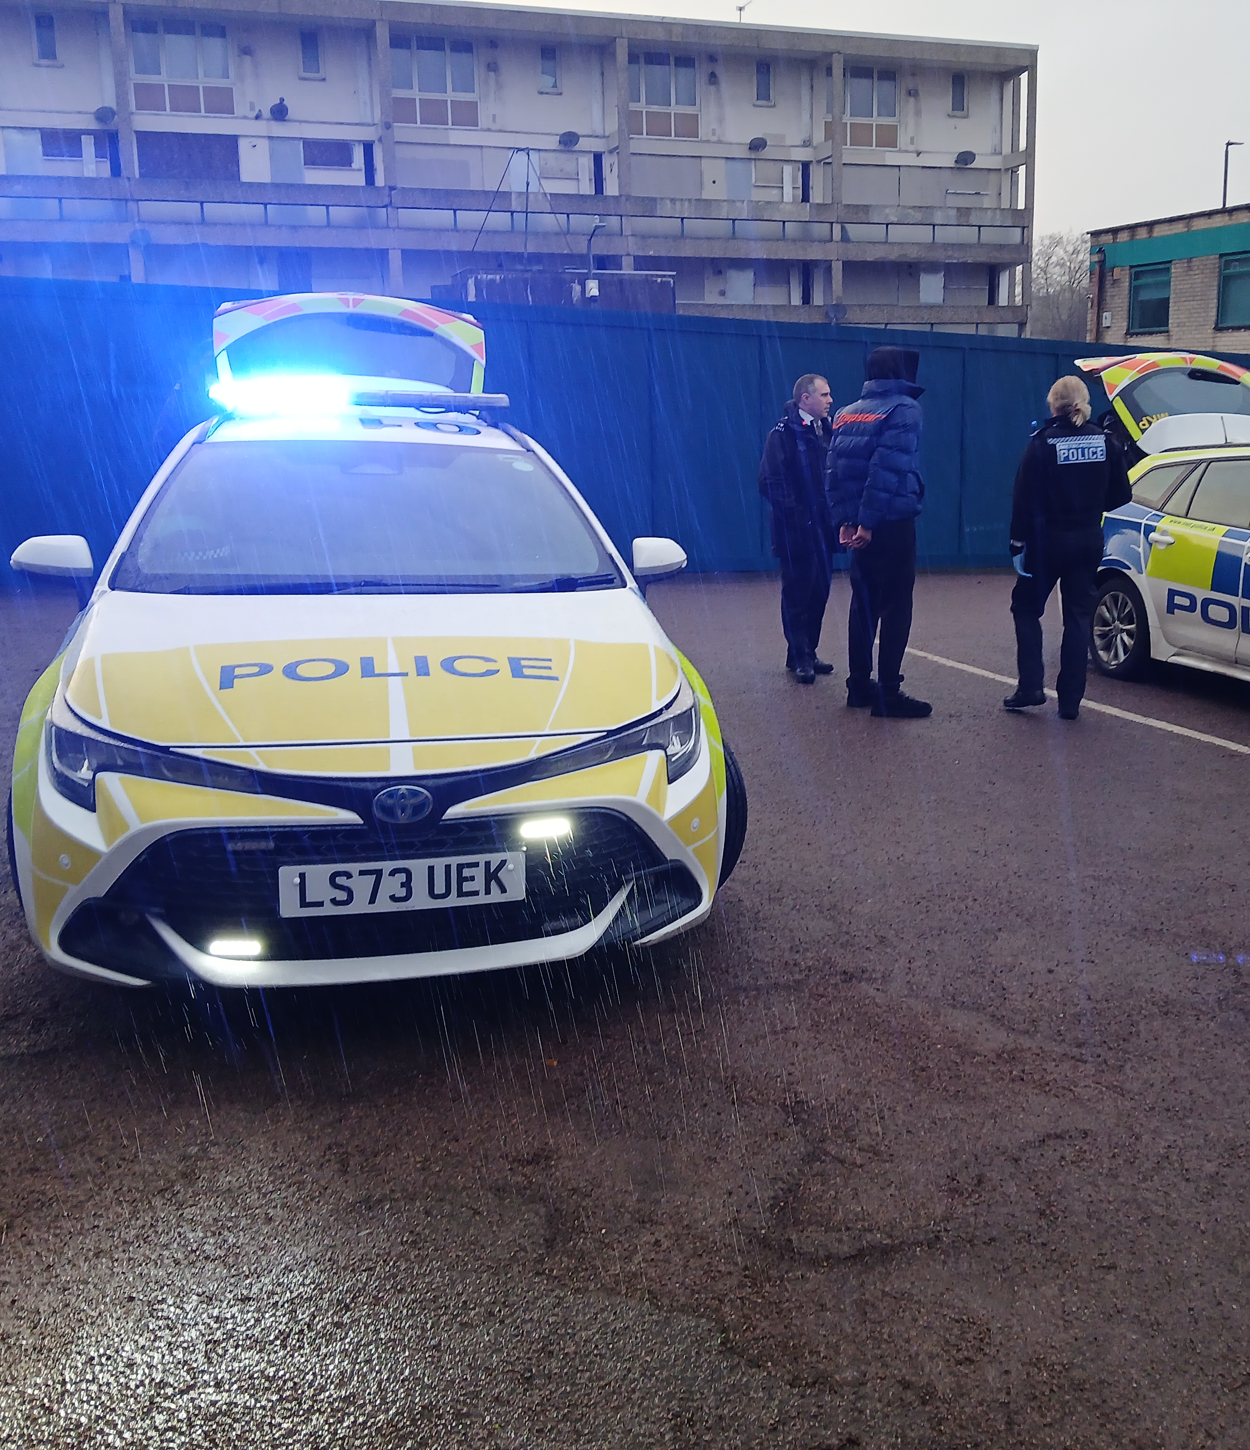
Police Activity
Arrests
10 arrests by Roehampton officers in the last quarter across the borough.
Pursuit of two e-bikes across Putney and Wimbledon Commons resulted in an arrest for a suspect wanted in Tower Hamlets.
Prolific squatter arrested and charged in connection with an address in Roehampton.
Man arrested and banned breed of dog seized following incident in March.

Slide 10
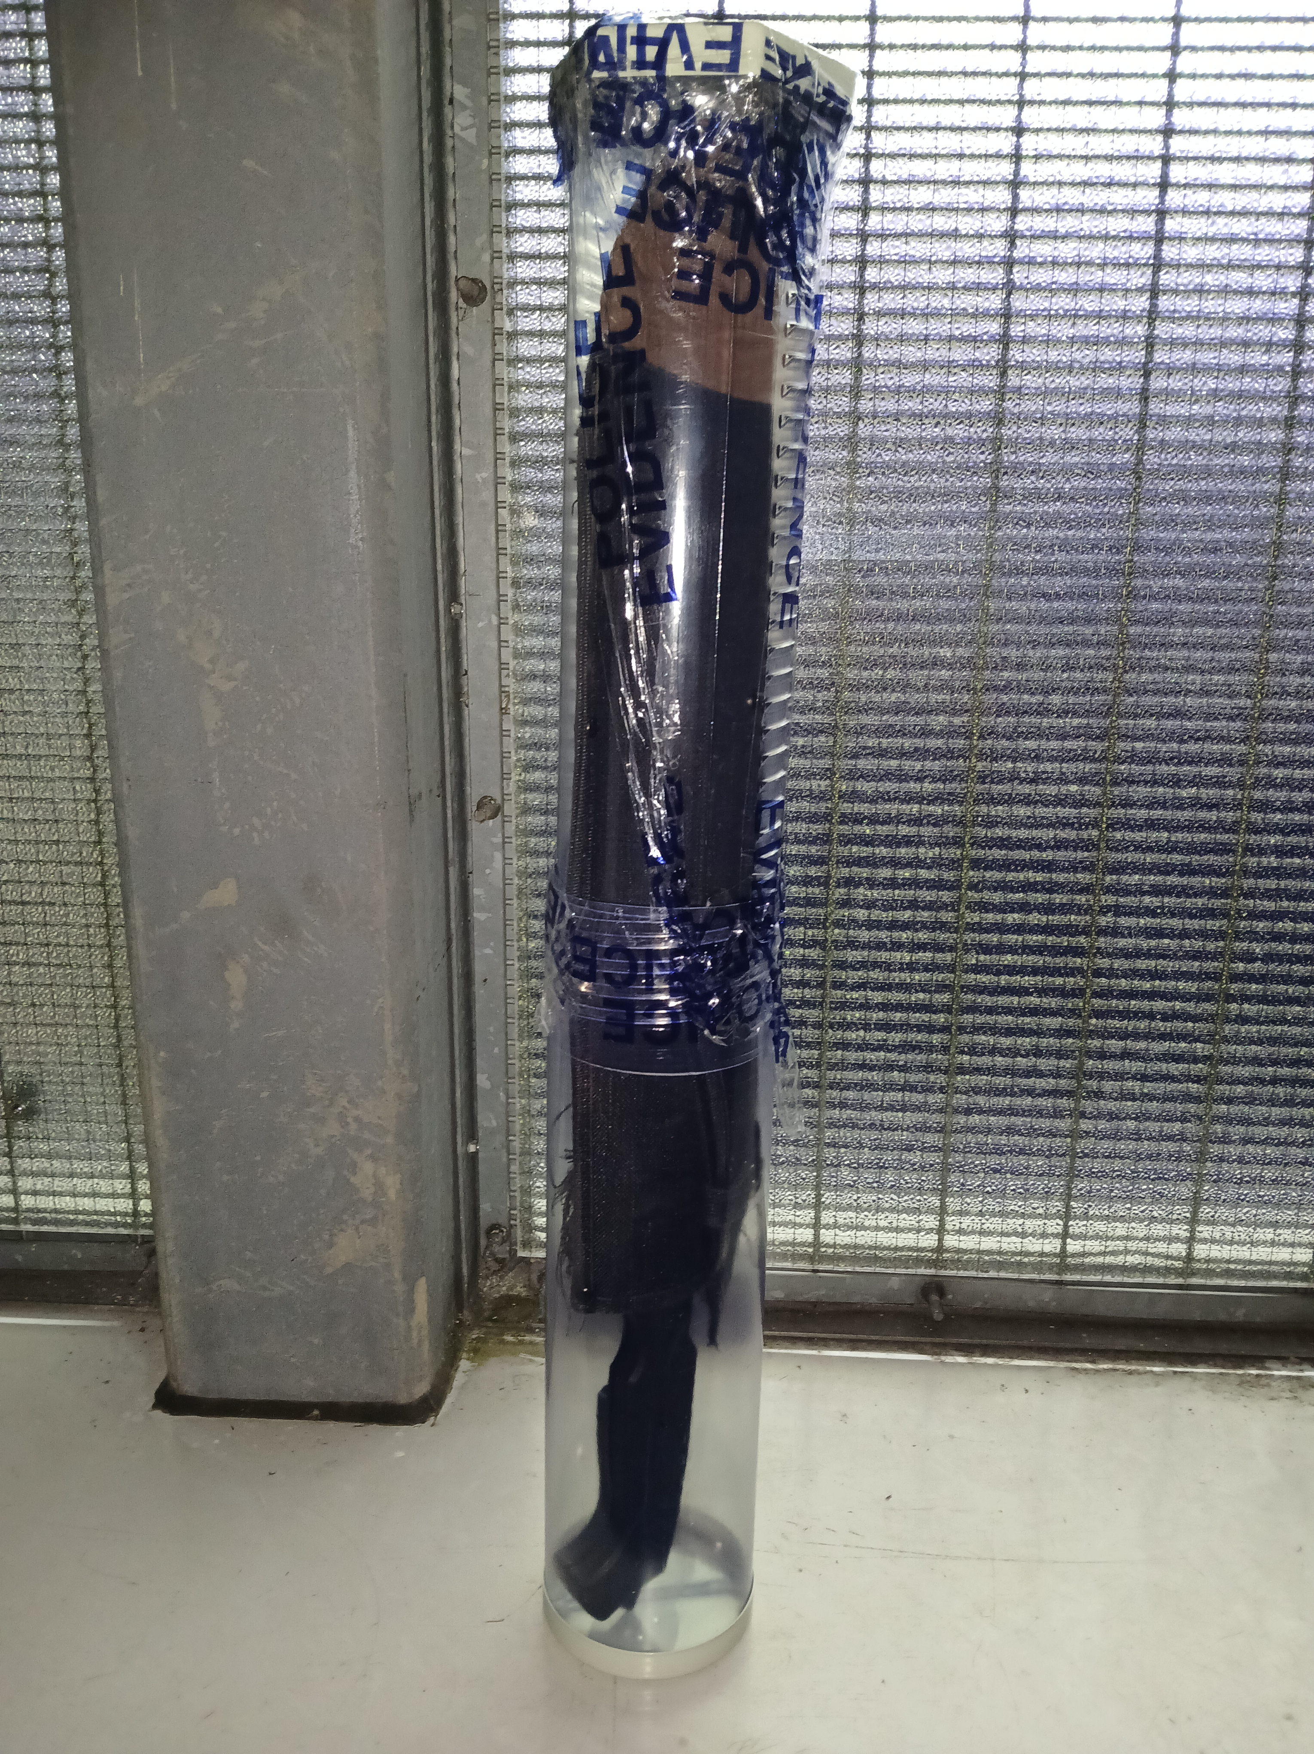
Police Activity
Proactivity
37 stop searches conducted on the ward over the last quarter.
6 conducted by your local officers, of which 3 were positive (50%).
4 vehicle stops conducted by Roehampton officers.
2 drivers reported for various traffic offences.
2 ASB warning letters issued for drug related nuisance and noise.
1 stolen van holding a machete and stolen bicycle recovered.

Slide 11

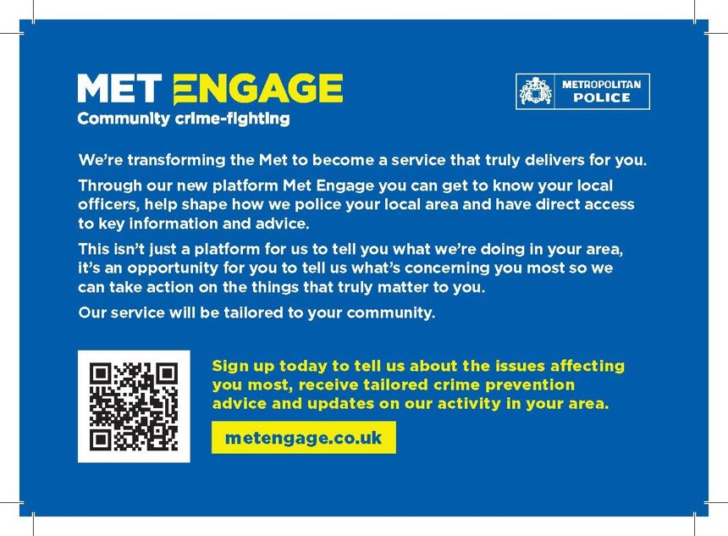
Met Engage
Community Crime Fighting
The Met are enrolling out a brand-new platform called Met Engage.
This platform will be the main platform for letting the community know what we are doing in the area, and for the community to feedback directly to our team with their thoughts.
If you like to stay up to date, please sign up here:
www.metengage.co.uk

Slide 12
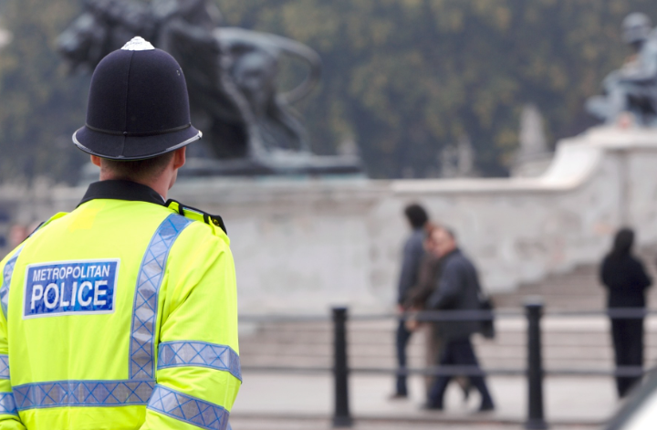
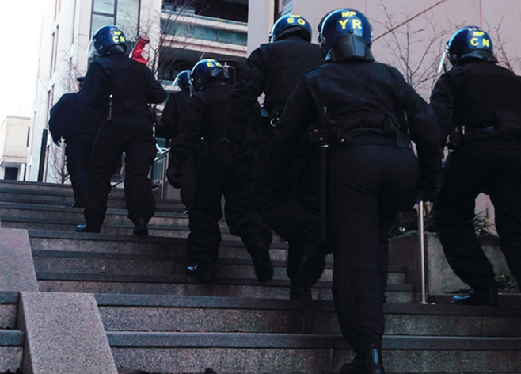
Abstractions
‘Abstractions’ refers to when we as officers are taken away from our regular duties to assist elsewhere.
The figure calculated below is out of days worked, not including training days, secondments, or annual leave. These also do not include taskings which do not divert an officer for the whole shift.
Last 3 Months:
PC Quail was abstracted for 20% of his shifts in the last quarter.
PC Gavin was abstracted for 50% of her shifts in the last quarter.
PC Mageean was abstracted for 12% of his shifts in the last quarter.
PC Ahmed was abstracted for 27% of his shifts in the last quarter.

Slide 13
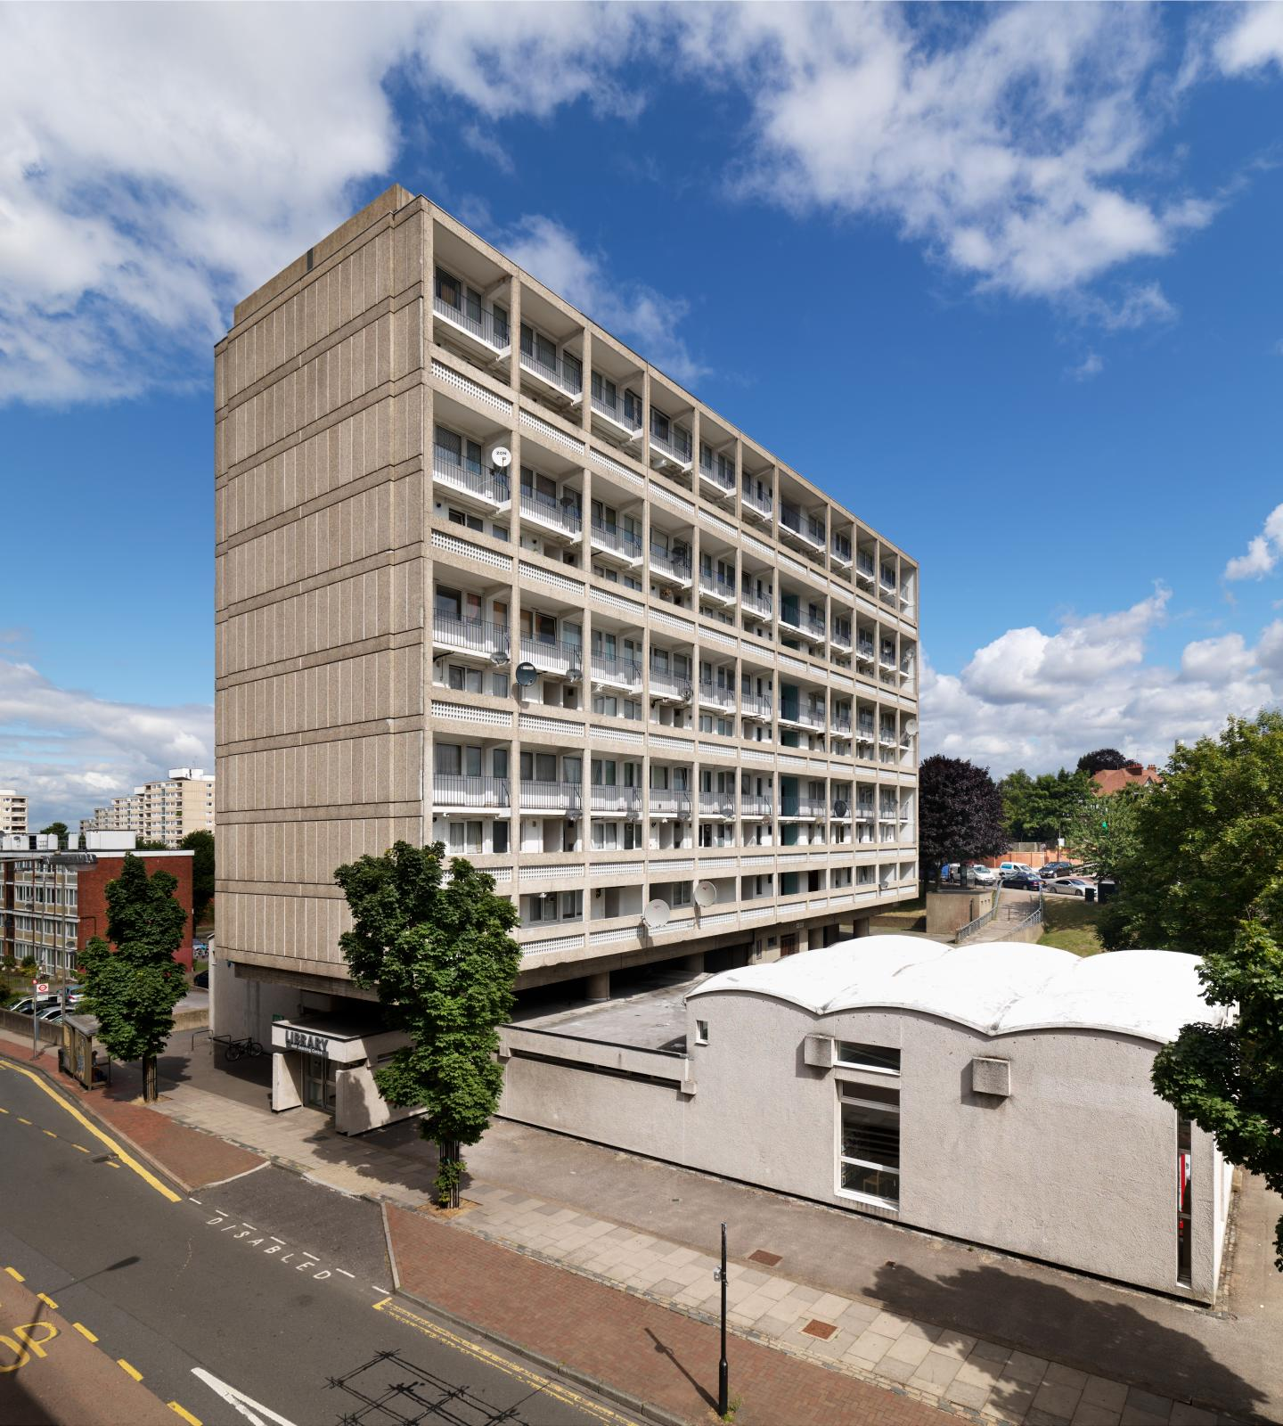
Ward priorities
Based on the current trends and figures, the ward team make a proposal for three new ward priorities.
Those being:
Drugs.
Anti-social behaviour.
Robbery.

Slide 14


Future Events
Next ward panel meeting – 13th or 27th Aug.
Bike marking event Roehampton Gate Richmond Park.
Bike marking event Queen Mary’s Hospital and/or Queen Mary’s Place.
Cuppa with a Copper at Roehampton Library.
Crime Prevention Walk/Talk.
Met Engage Door to Door.
Dates and times to be confirmed

Slide 15
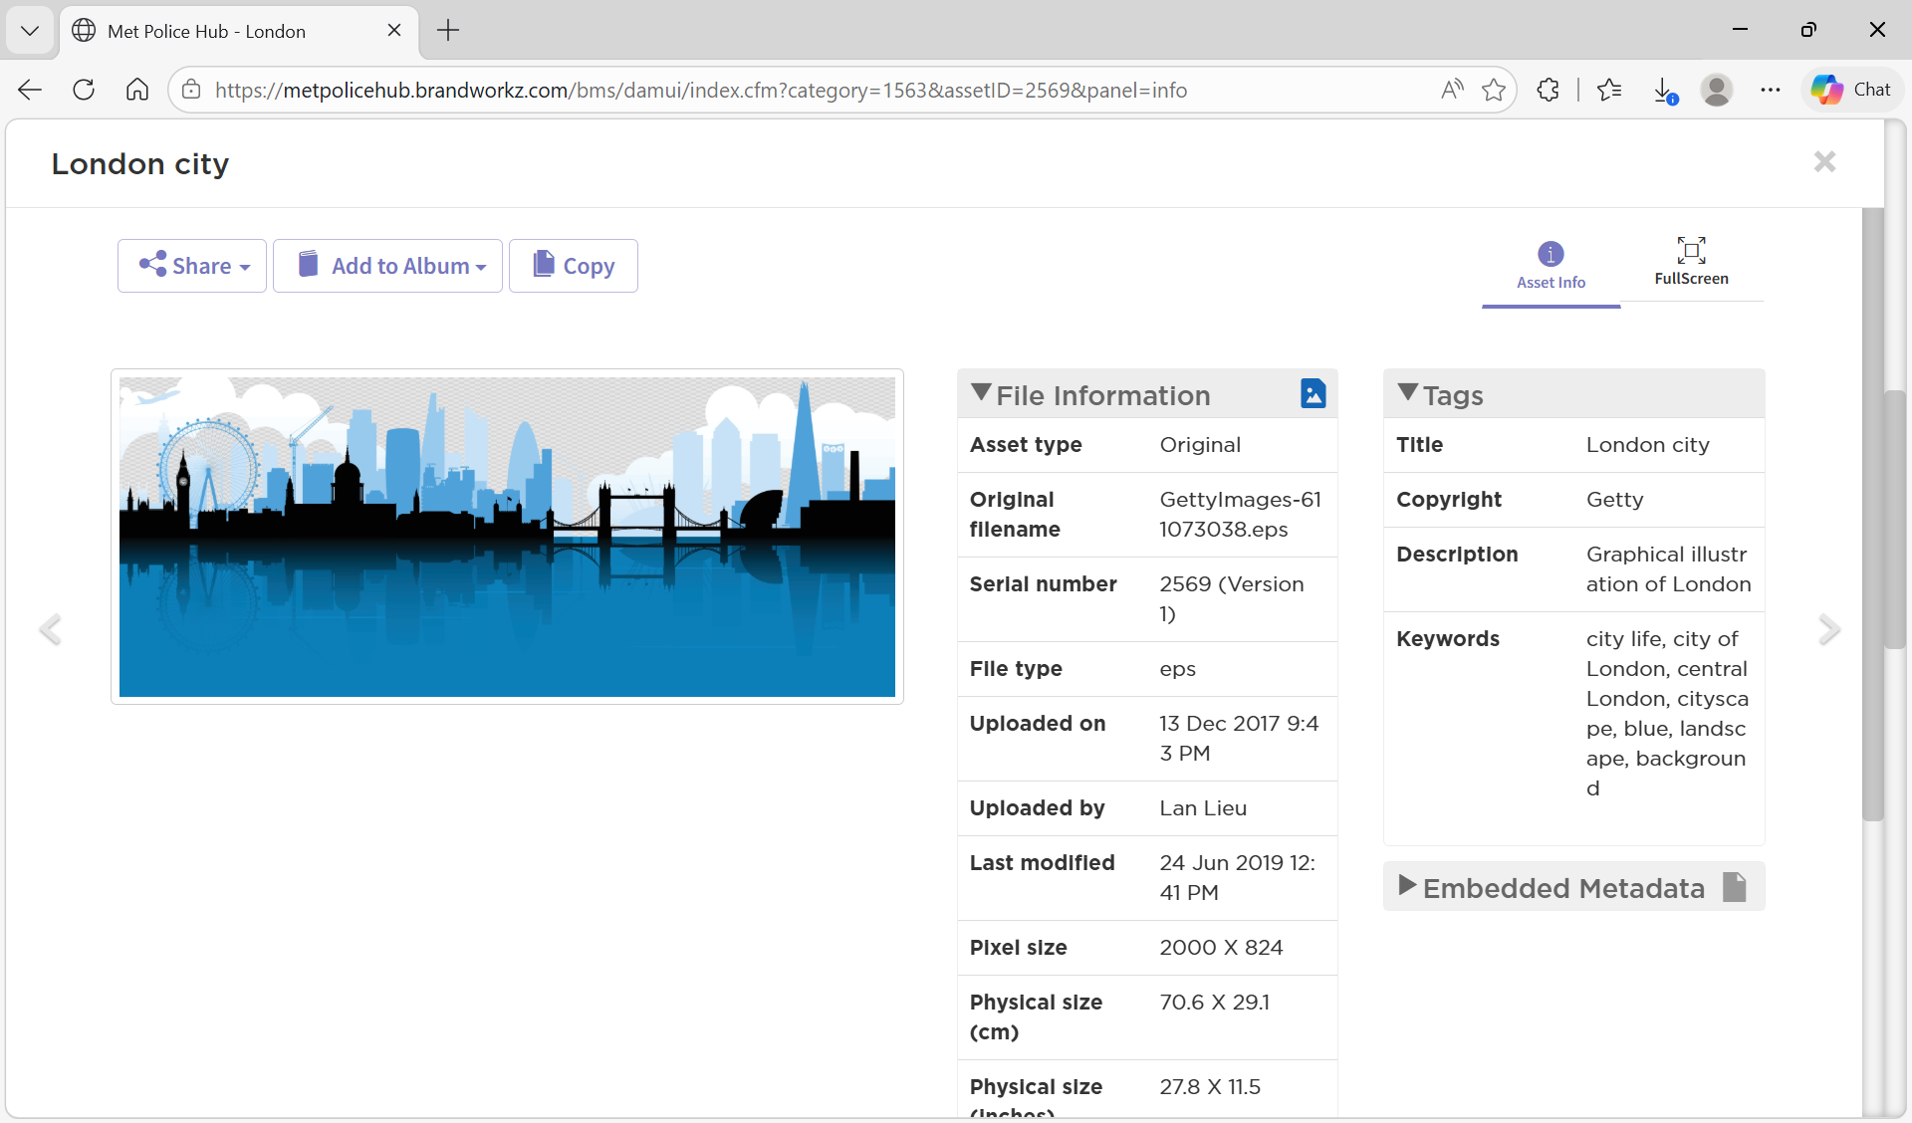
Questions?

Slide 16

Thank you for attending!

