Slide 1

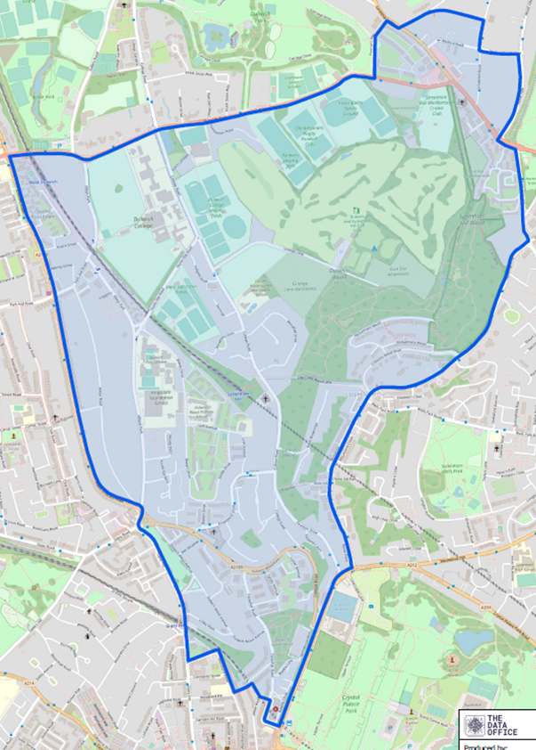

Dulwich Wood Ward Panel Meeting
12th October 2026

Slide 2
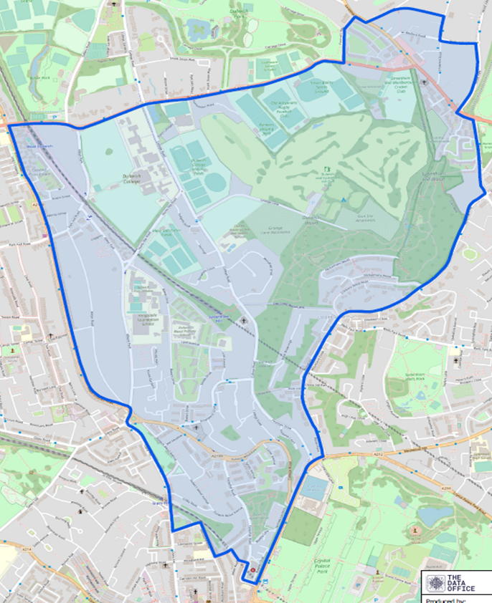
Your Local SNT officers:
PS Derek MAY
PC Francesca WAKE
PC Megan POWLEY
PC Ethan WONG
PCSO Simon JOHNSON
PCSO Ed MUSTAFA
dulwichwood@met.police.uk
Total Abstractions 1ST JULY – 30TH SEPTEMBER
Abstractions are defined as working days away from the ward such as Southwark wide enforcement days of action, staffing up response team, reassurance patrols, Central AID, etc.
Sgt – 15 PC – 55 PCSO – 12

Slide 3
Key stories:
As many of you will know, PC Ben Comfort left the Metropolitan Police on 6 July to take up a new role with Transport for London. We thank Ben for his contribution to the ward and wish him every success in his new position. On 5 October, we welcomed PC Ethan Wong to the Dulwich Wood Safer Neighbourhood Team. Ethan has recently completed his police training and is enthusiastic, highly motivated, and keen to begin working with the local community. He will be permanently based on Dulwich Wood Ward.
PC Wake and PC Spencer-Avinson from Dulwich Village SNT arrested two prolific local nominals identified on the ward. One was wanted for failing to appear at court on two occasions, while the second was identified by local officers as being responsible for a parcel theft. Both were arrested, with the latter subsequently charged. Whilst the stolen parcel was of relatively low value (£19) and was recovered for the victim, it demonstrates our continued commitment to identifying offenders and taking positive action against those impacting our community.
Whilst on patrol, PCSO Mustafa and PCSO Johnson identified a well-known local nominal linked to burglary and theft offences across the ward. The individual had been wanted for multiple offences for over six months. Following their intervention, the male was detained, arrested, charged, and remanded into custody to await court proceedings.
PC Wake attended Croydon Magistrates' Court to give evidence against a prolific local shoplifting offender. Following the hearing, the defendant was found guilty, with sentencing scheduled for the end of October.
We also said goodbye to our former inspector, Insp. Wilson, and welcomed our new inspector, Insp. Muriel, who is keen to meet residents, support local priorities, and spend time out on patrol across the wards she oversees.

Slide 4
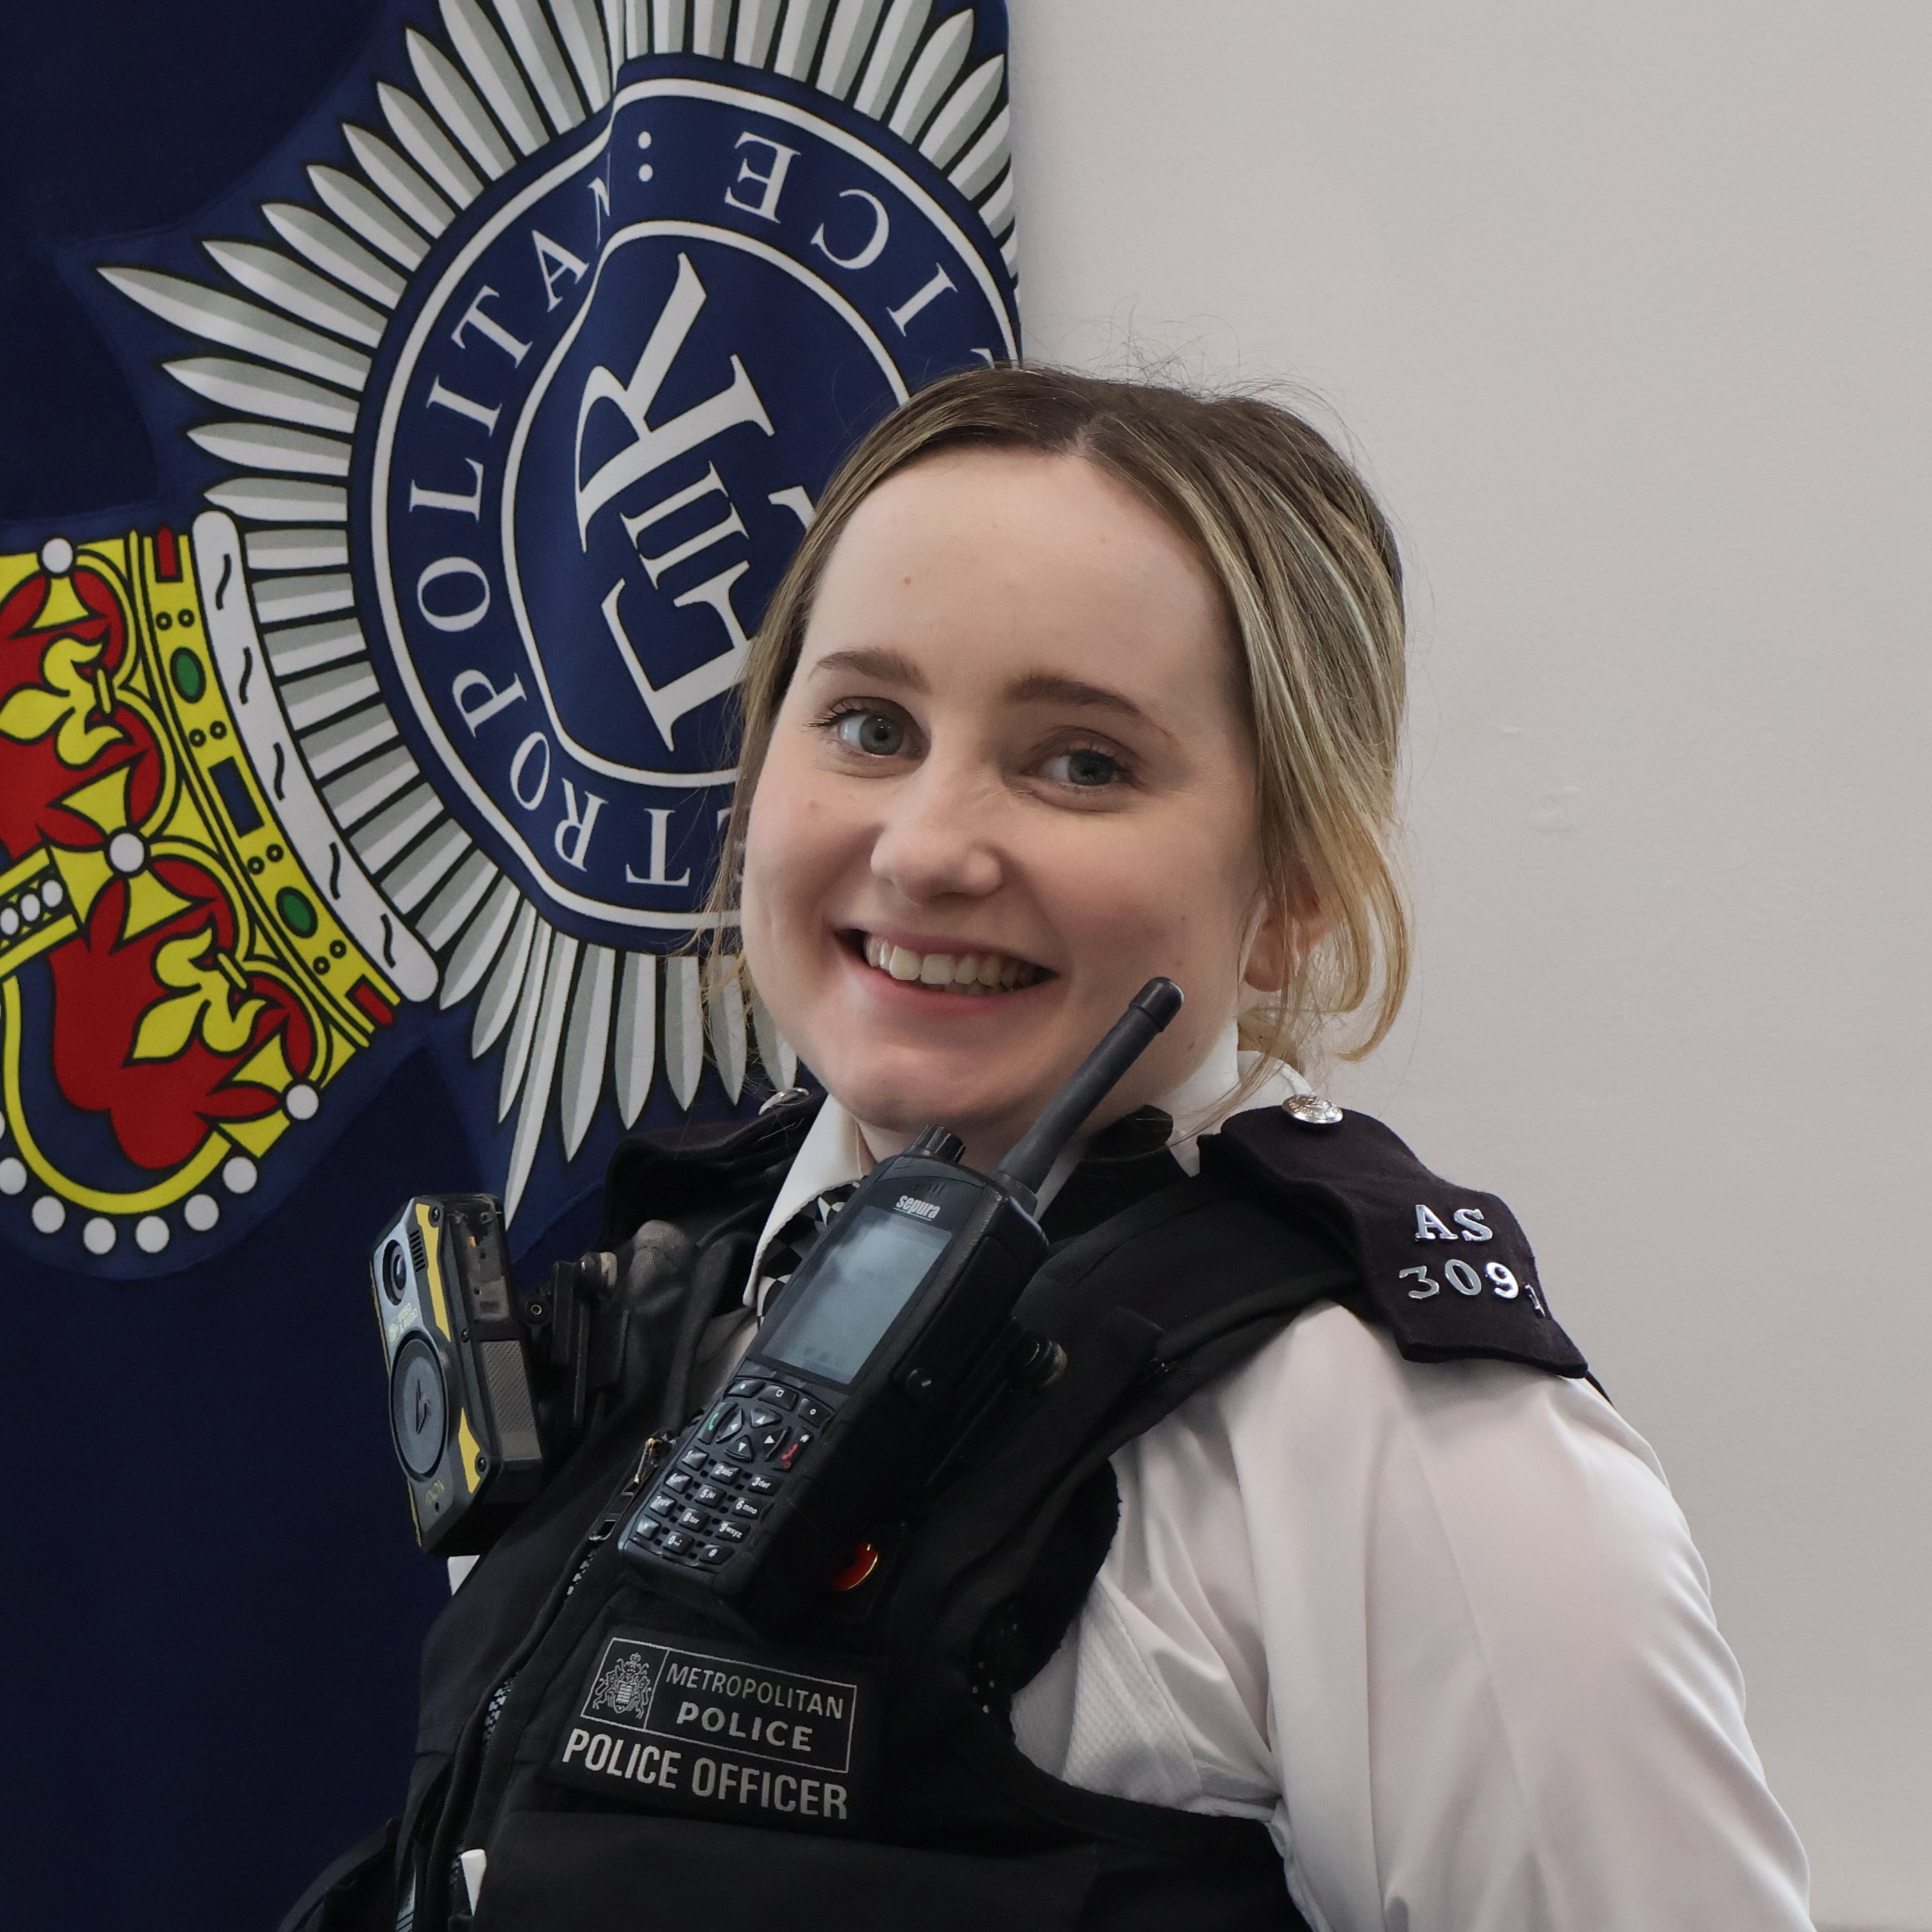
A Personal Update:
The final update is a more personal one.
After four and a half incredibly rewarding years serving the residents of Dulwich Wood, I will be leaving the ward at the end of October to take up a role within Counter Terrorism Policing.
Serving as your local ward officer has been both a privilege and an honour. Throughout my time here, I have had the opportunity to work alongside residents, Ward Panel members, councillors, local businesses, schools, and partner agencies to tackle issues that matter to our community. Together, we have addressed crime and anti-social behaviour, supported vulnerable residents, and built strong relationships that have made Dulwich Wood such a special ward to police.
I am immensely proud of everything we have achieved over the last four and a half years. The ward has given me experiences, opportunities, and friendships that I will carry throughout my career. Whilst I am excited to begin this new chapter, Dulwich Wood will always hold a special place in my heart. I would like to sincerely thank everyone who has supported me, challenged me, and worked alongside me during my time here.
It has genuinely been a pleasure serving this community, and I leave knowing the ward remains in very capable hands.
Thank you for allowing me to be your ward officer.

Slide 5
Crime Summary – Year on Year Comparison
 | PERIOD THIS YEAR | PERIOD LAST YEAR | YOY Difference
Robbery | 3 | 4 | -1
Theft from motor vehicle | 15 | 10 | +5
Theft of motor vehicle | 15 | 13 | +2
Burglary (residential) | 10 | 12 | -2
Burglary (commercial) | 3 | 5 | -2
Theft from Person | 11 | 7 | +4

Slide 6
Theft from Motor Vehicle
JULY-SEPTEMBER:
Theft from Motor Vehicle: 15
Interference with Motor Vehicle: 5
Trends:
Number plate thefts remain the most common offence type, accounting for 5 of the 20 reports (25% of all incidents).
Acacia Grove was the most affected location, recording three separate offences, including two thefts and a stolen disabled parking permit.
Glazebrook Close also experienced repeat offending, with two separate theft from motor vehicle reports.
Several offences involved items being stolen from within vehicles, suggesting offenders are targeting vehicles where property has been left visible or accessible.
Lexus vehicles appear to be a specific target, with two separate incidents on Hitherwood Drive where offenders cut holes into the tailgate in an apparent attempt to steal the vehicle.
Catalytic converter crime remains present, with both a completed theft (Toyota Prius) and an attempted theft (Honda Civic) reported during the period.
Vans continue to be targeted for tools and equipment, including a theft from a van on Dulwich Wood Avenue and an attempted theft on Lyall Avenue.
Notes:
Secure registration plates with anti-theft screws.
Remove all valuables and personal belongings from vehicles.
Consider additional security measures for higher-risk vehicles, including steering locks, tracking devices and catalytic converter protection.
Tradespeople should remove tools from vehicles overnight wherever possible.
Residents are encouraged to report suspicious behaviour around parked vehicles immediately.
Speaker Notes
Vehicle crime remains an issue across the ward, with 20 recorded offences during this period. The most noticeable trend was the number of registration plate thefts, which made up a quarter of all incidents. Acacia Grove and Glazebrook Close experienced repeat offences, while Lexus vehicles were specifically targeted in two separate incidents on Hitherwood Drive. We also continue to see catalytic converter offending and thefts from vans, highlighting the need for continued vigilance and preventative security measures.

Slide 7
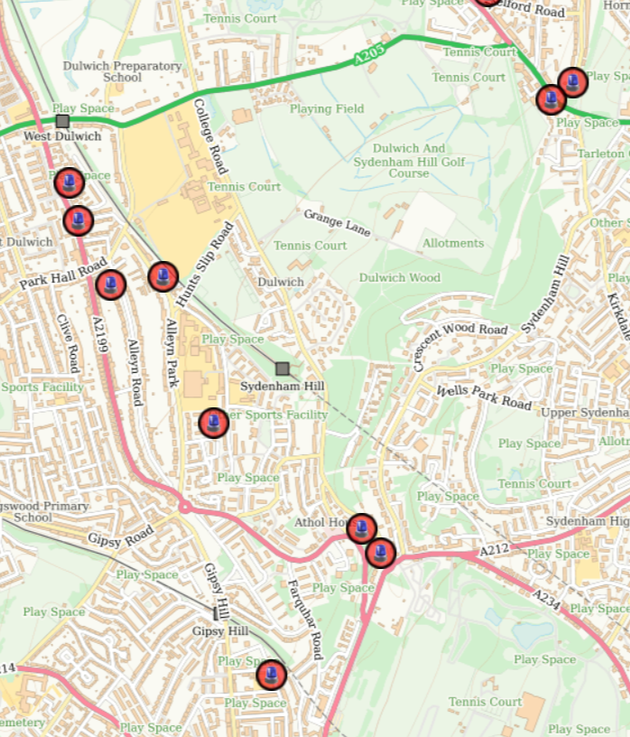
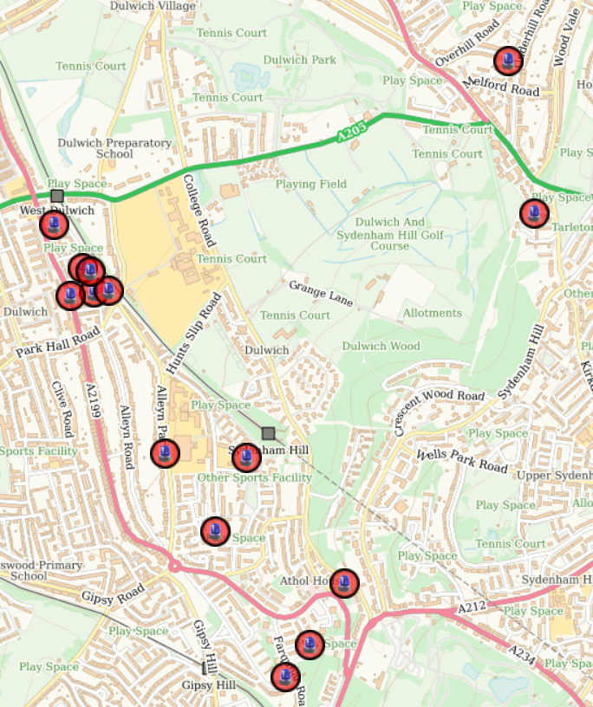
Theft from Motor Vehicle MAP
JULY-SEPTEMBER:
PERIOD LAST YEAR
PERIOD THIS YEAR

Slide 8
Theft of Motor Vehicle
JULY-SEPTEMBER:
Theft of Motor Vehicle: 15
Trends:
Dulwich Wood Avenue recorded the highest number of thefts, with three vehicles stolen during the reporting period.
Farquhar Road experienced three separate vehicle thefts, making it another significant hotspot location.
A number of stolen vehicles were subsequently recovered, demonstrating that offenders are often moving vehicles away from the immediate area rather than retaining them locally.
Pick-up trucks and larger vehicles appear particularly attractive to offenders, with two Nissan Navaras stolen during the period.
Several offences involved vehicles stolen despite owners taking preventative measures, including a Honda stolen from Peckarmans Wood whilst both keys were reportedly stored in a Faraday pouch.
Higher-value vehicles continue to be targeted, including a BMW 5 Series, Maserati Levante, and Hyundai Tucson.
The most serious incident involved the robbery of a vehicle on Jasper Road, where a machete was used to gain access to the vehicle.
Theft of work vehicles remains an issue, with a Toyota van containing tools stolen from Crystal Palace Parade.
Two separate thefts occurred on Crescent Wood Road, including a motorbike theft and a stolen Kia Niro.
Notes:
We recorded 15 thefts of motor vehicles during this reporting period. The most affected locations were Dulwich Wood Avenue and Farquhar Road, which each recorded three separate offences. A range of vehicles were targeted, from family cars and motorcycles through to higher-value vehicles including a BMW 5 Series and Maserati Levante.
We also continue to see offenders targeting commercial vehicles and pick-up trucks, particularly where they may believe valuable tools or equipment are stored inside. Two Nissan Navaras were stolen during this period, while a Toyota van containing tools was also taken.
Encouragingly, a number of stolen vehicles were recovered following the offences, including vehicles stolen from Crescent Wood Road, College Road and Dulwich Wood Avenue. However, the figures demonstrate that vehicle theft remains a key issue across the ward.
The team has carried out crime prevention visits to repeat victims and vulnerable victims where appropriate, providing reassurance and tailored security advice to help reduce the likelihood of further offences.
Prevention advice includes:
Storing vehicle keys well away from doors, windows and letterboxes.
Using a signal-blocking pouch, whilst recognising that additional physical security measures such as steering wheel locks provide another layer of protection.
Considering tracking devices or vehicle immobilisers, particularly for higher-value vehicles.
Parking in well-lit areas and making use of CCTV or video doorbells where available.
Removing tools and valuables from vehicles overnight and avoiding leaving any items on display.
Reporting suspicious activity, unknown persons checking vehicles, or vehicles repeatedly driving slowly around residential roads.
We will continue to monitor trends, identify any emerging hotspot locations, and provide preventative advice to residents affected by vehicle crime.

Slide 9
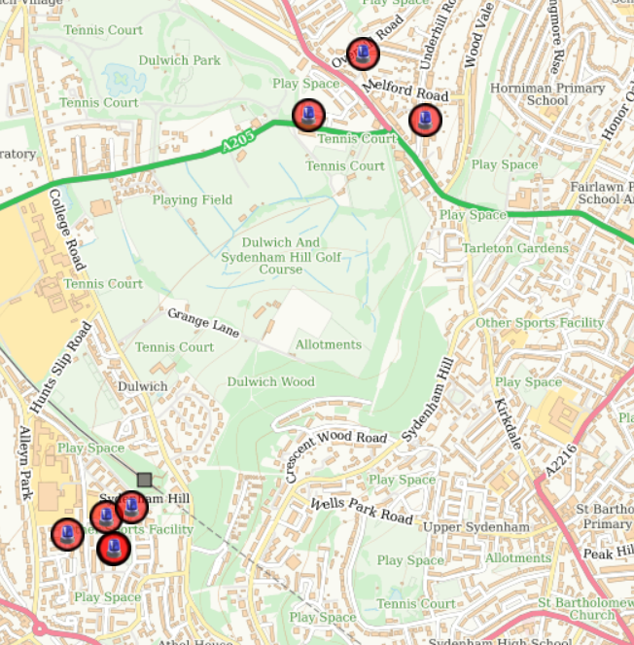
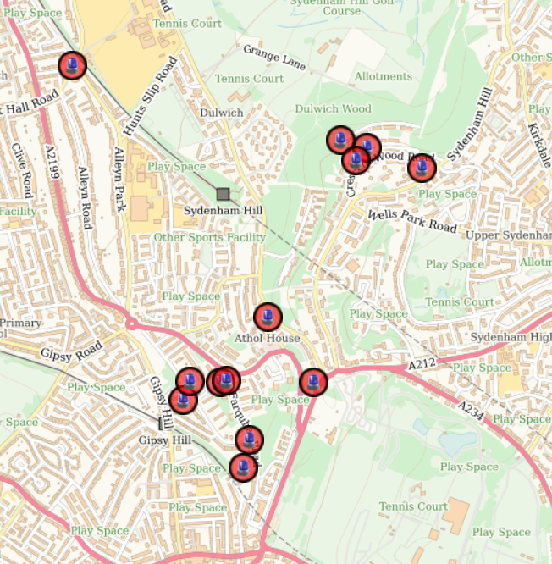
Theft of Motor Vehicle MAP
JULY-SEPTEMBER:
PERIOD LAST YEAR
PERIOD THIS YEAR

Slide 10
Burglary
JULY-SEPTEMBER:
Business/Commercial: 3
Residential: 10
Trends:
Residential Burglary: 8 (plus 2 offences relating to outbuildings/communal storage areas)
Lordship Lane accounted for 4 of the 8 residential burglaries, making it the most affected location during this period.
A number of offences occurred within the vicinity of supported accommodation addresses or involved vulnerable occupants, with no wider pattern identified affecting surrounding residential properties.
The most significant confirmed residential burglary occurred on Fountain Drive, where offenders forced entry through the front door and stole a safe during daytime hours.
Another notable offence occurred on Lordship Lane, where offenders gained entry through a crowbarred basement door whilst the occupants were away for an extended period, stealing personal documents including a passport.
Two additional offences related to outbuildings and communal areas, including stolen bicycles and a parcel theft.
Commercial Burglary: 3
Farquhar Road: Bike storage area broken into and bicycles stolen.
Sydenham Hill: CCTV equipment stolen from a business premises.
Park Hall Road: Garden centre burglary, with two suspects identified by local officers and subsequently arrested.
Notes:
We recorded eight residential burglaries during this period, although it is worth noting that several reports were linked to supported accommodation settings or circumstances where, following investigation, the incidents were believed to be connected to the occupant's vulnerability rather than a conventional burglary offence.
Lordship Lane accounted for half of all residential burglary reports during this reporting period, making it the ward's most affected location. The most significant confirmed burglary involved a property on Fountain Drive where offenders forced entry during the daytime and stole a safe. We also saw an offence on Lordship Lane where a property was targeted whilst the occupants were away for a prolonged period.
We continue to carry out reassurance visits to burglary victims, providing crime prevention advice and support following these often distressing offences. The team has also spent considerable time reviewing CCTV opportunities and carrying out local enquiries to identify offenders and develop intelligence.
A positive update is that I, PC Wake, will be attending court in December in relation to a burglary offence on the ward where I identified the suspect through local enquiries and investigation. This demonstrates the value of officers knowing their local offenders and communities.
In relation to commercial burglaries, three offences were recorded. Most notably, following a burglary at a garden centre on Park Hall Road, two suspects were identified by local officers and arrested.
Prevention advice for residents includes:
Ensuring all doors and windows are locked, even when at home.
Using timer switches on lights when away from home.
Asking trusted neighbours to keep an eye on properties during holidays and prolonged absences.
Registering valuables and marking high-value property where possible.
Ensuring side gates, sheds and garages are secure with quality locks.
Maintaining CCTV, video doorbells and exterior lighting where available.
Reporting suspicious behaviour promptly, particularly individuals seen entering gardens or rear access routes without legitimate reason.

Slide 11
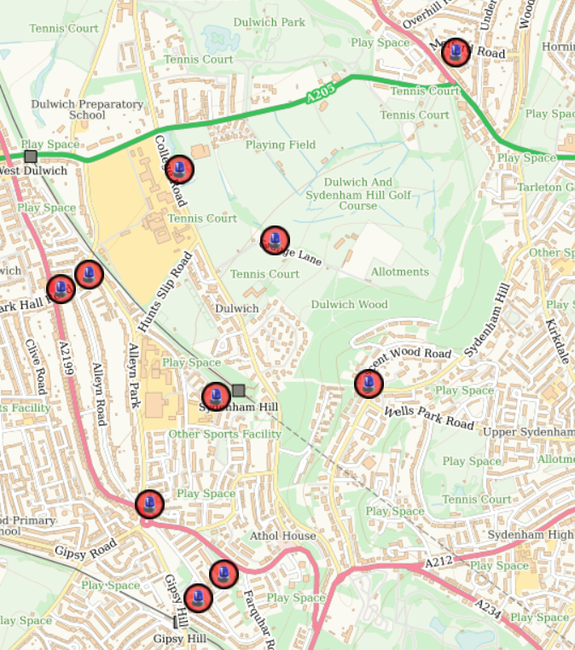
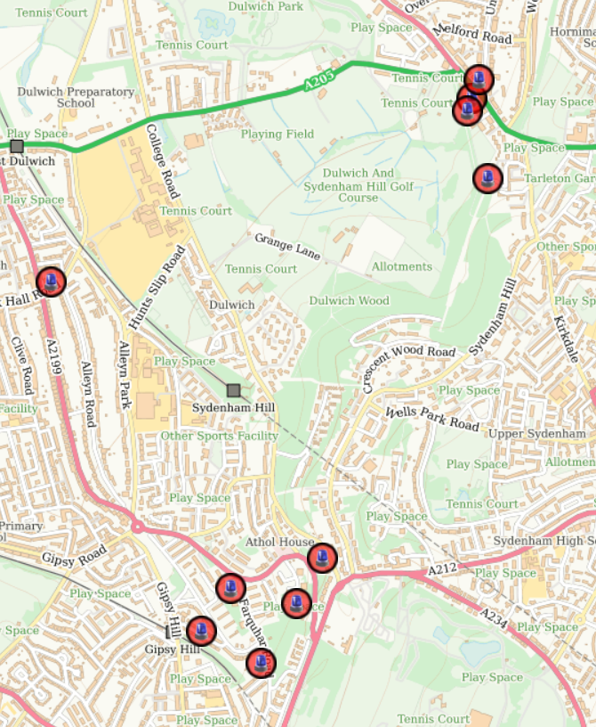
Burglary MAP
JULY-SEPTEMBER:
PERIOD LAST YEAR
PERIOD THIS YEAR

Slide 12
Robbery
JULY-SEPTEMBER
Robbery: 3
Trends:
Robbery: 3
2 school-age victims targeted on Huntslip Road.
In both incidents, the suspects demanded mobile phones and implied they were carrying a knife before taking the phones.
Glazebrook Close: Victim threatened with a hammer and had an e-bike stolen.
Attempted Robbery: 0
As we move into the autumn and winter months, we are entering a period when robbery offences traditionally increase due to darker evenings and reduced natural surveillance. Recognising this, we have a local policing plan in place focusing on the darker nights period.
Officers will continue to carry out school patrols whenever operationally possible, particularly during school start and finish times, and in areas where young people travel to and from school. These patrols provide reassurance, opportunities for engagement with students, and a visible police presence to deter offending.
Notes:
We recorded three robberies during this reporting period. Whilst the numbers remain relatively low, robbery is one of the most impactful crimes due to the fear and trauma it can cause victims.
Of particular concern were the two incidents on Huntslip Road involving school-age children who were targeted for their mobile phones. In both cases, suspects implied they were carrying a knife, which understandably caused significant distress to the victims. We are also encouraging young people and parents to take some simple preventative measures:
Keep mobile phones out of sight when walking in public areas.
Avoid using phones while walking, particularly when alone or distracted by headphones.
Remain aware of surroundings and trust instincts if something feels wrong.
Travel with friends where possible, especially during darker evenings.
Report suspicious behaviour immediately and call 999 if someone is being threatened or an offence is in progress.
Consider enabling phone tracking applications and ensuring device security features are activated.
Whilst robbery figures remain relatively low on the ward, we will continue to monitor any emerging trends closely and maintain a visible presence around schools, transport routes and identified hotspot locations.

Slide 13
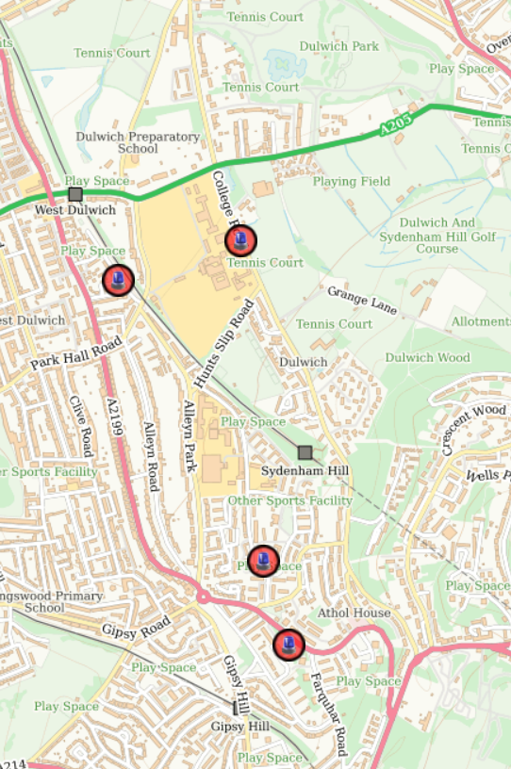
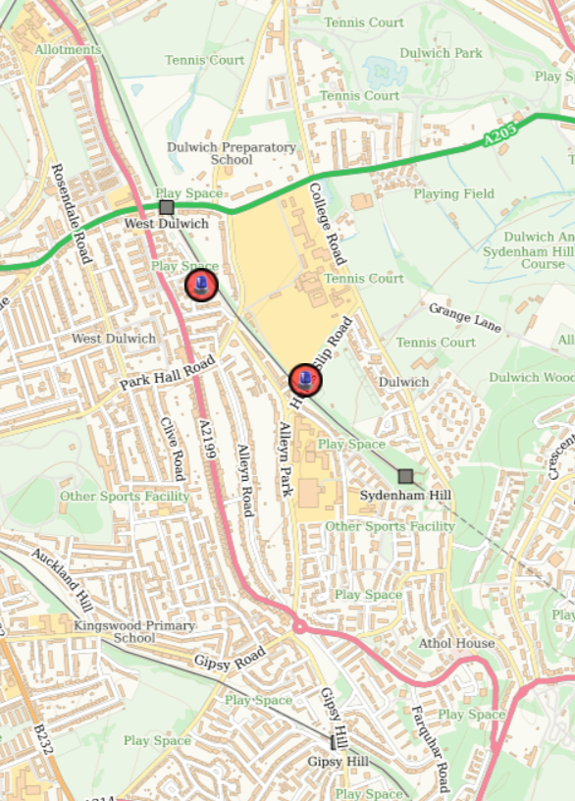
Robbery MAP
JULY-SEPTEMBER:
PERIOD LAST YEAR
PERIOD THIS YEAR

Slide 14
Theft from person
JULY-SEPTEMBER
Theft from person: 11
Attempted theft: 1
Trends:
7 of the 11 thefts from person involved phones being snatched by suspects on e-bikes or scooters.
Dulwich Common was the most affected location, recording two separate phone snatch incidents.
Most offences occurred during daylight and commuting hours, with incidents recorded between 7:30am and 12pm, showing offenders are operating at all times of day rather than solely after dark.
School-age victims featured in two linked incidents on Seeley Drive, where phones were taken by known youths.
The majority of offences involved the quick snatching of mobile phones, allowing suspects to make off before police attendance.
One offence on Dulwich Wood Park involved a victim handing over a watch after fearing violence.
Notes:
We recorded 11 thefts from person and 1 attempted theft during this period. The most significant theme continues to be phone snatches committed by offenders using e-bikes and scooters. Seven of the eleven offences fell into this category.
Unfortunately, this type of offending presents a significant challenge for policing. In many cases, by the time an offence is reported the suspects have already travelled a considerable distance and often crossed borough boundaries. Due to the risks posed to members of the public, police officers cannot simply pursue every e-bike or scooter rider through busy streets without considering public safety.
Whilst there are specialist tactics being trialled elsewhere in London, including specially trained officers using off-road motorcycles in central London areas with exceptionally high levels of this offending, the volume of offences in our area does not currently justify that capability being deployed locally.
One positive development is the continued work taking place around the Crystal Palace border area. We are working closely with local councillors and policing teams across five neighbouring boroughs to share intelligence, identify offenders and tackle the cross-border nature of this crime. I'd particularly like to thank Francis, as well as Councillors Sean and Ruth, for their support and engagement in helping drive this partnership approach.
Moving forward, residents can help reduce the risk of becoming victims by:
Keeping mobile phones out of sight when not in use.
Avoiding using phones near the roadside where offenders on bikes can easily grab them.
Remaining aware of surroundings, particularly when walking with headphones on.
Using tracking applications such as Find My iPhone or Android Device Manager.
Enabling PIN, facial recognition and remote-locking features on devices.
Recording IMEI numbers and ensuring cloud backups are activated.
Reporting suspicious e-bike or scooter behaviour immediately, particularly where individuals are repeatedly targeting pedestrians.
Whilst these offences remain difficult to prevent entirely, we continue to work with neighbouring boroughs and partners to identify offenders, understand emerging trends and reduce opportunities for phone-snatch robbery and theft across the ward.

Slide 15
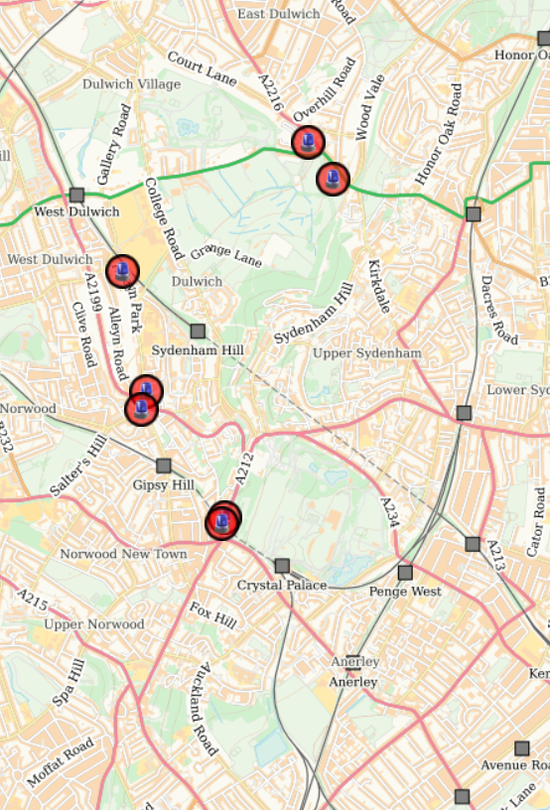
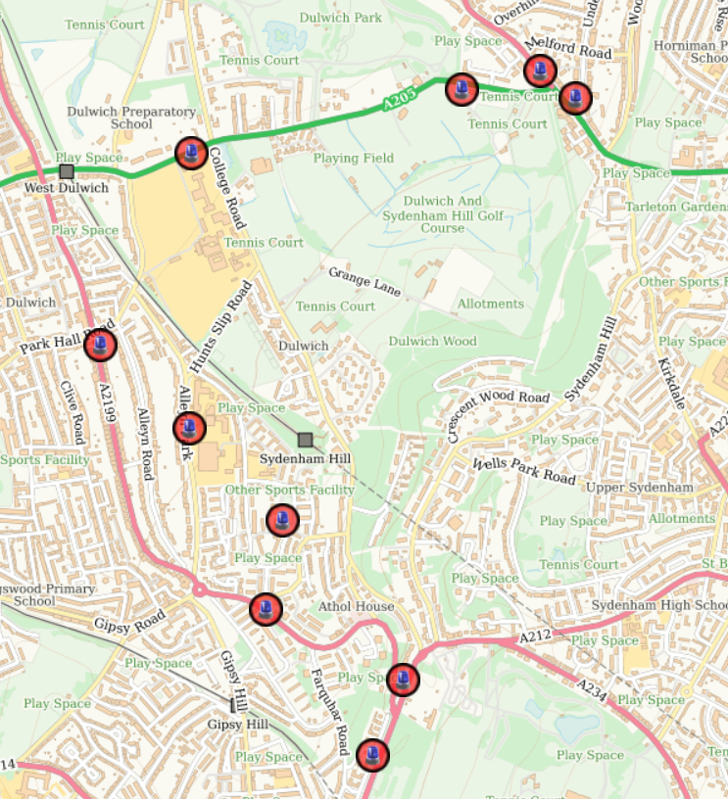
Theft from person MAP
JULY-SEPTEMBER:
PERIOD LAST YEAR
PERIOD THIS YEAR

Slide 16
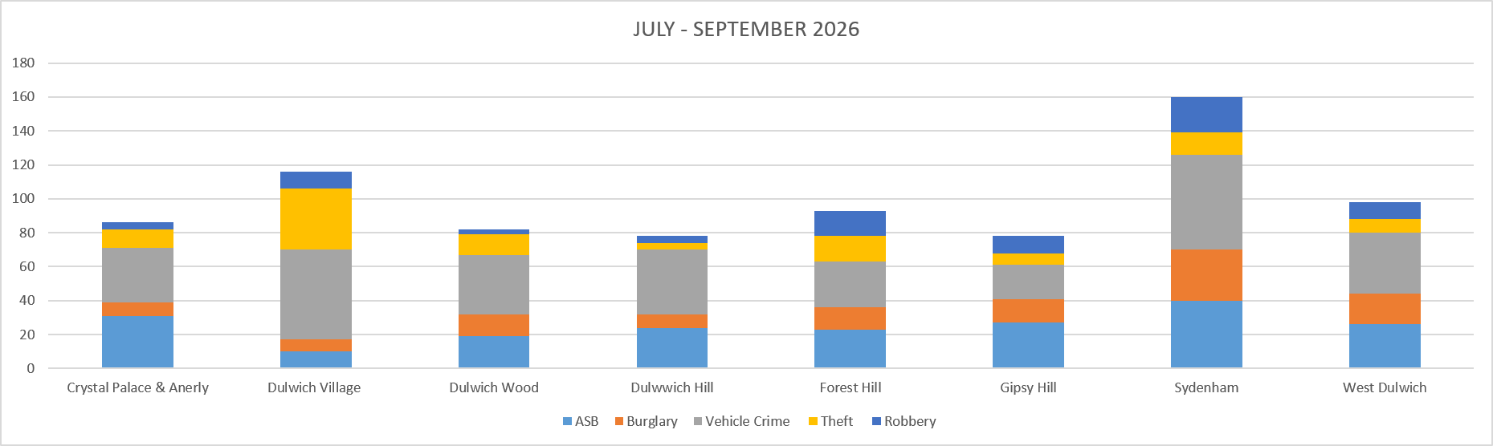
Bordering Wards Comparison

Slide 17
Southwark Wards Comparison JULY-SEPTEMBER 2026

Slide 18
Southwark Wards Comparison JULY-SEPTEMBER 2026

Slide 19
Southwark Wards Comparison JULY-SEPTEMBER 2026

Slide 20
Southwark Wards Comparison JULY-SEPTEMBER 2026

Slide 21


Met Engage and Ward Priorities
Current Ward Priorities:
Dulwich Wood:
1) Burglary
2) Motor Vehicle Crime
3) Robbery/ASB on estates

